Slide 1


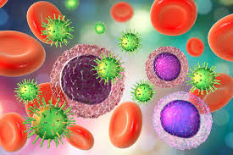
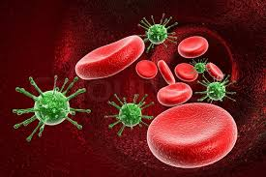
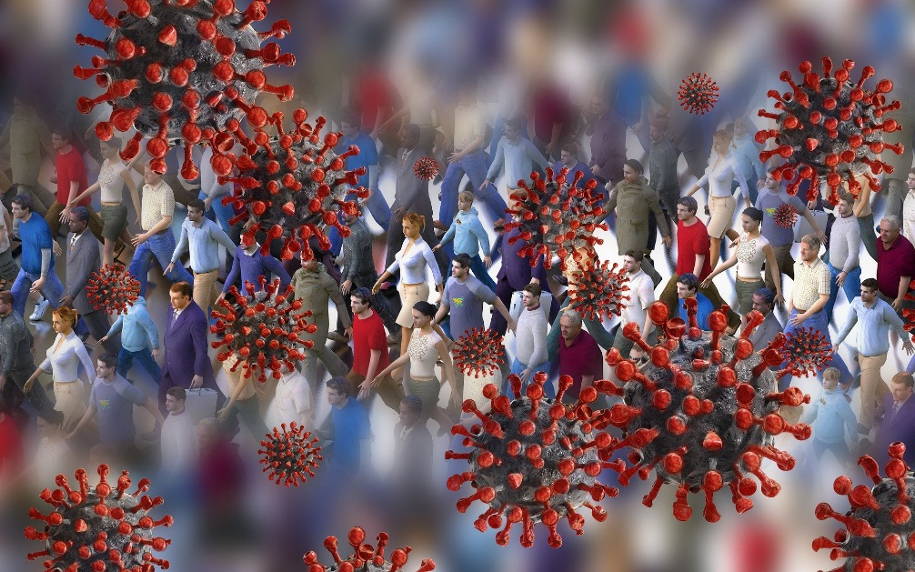
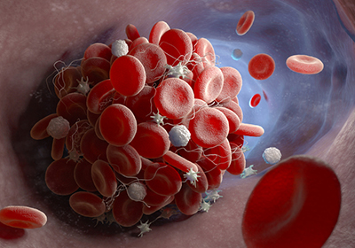
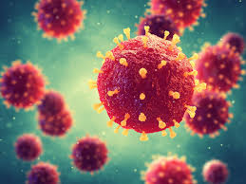

Covid -19 hematological and Biochemical Parameters
Dr.S.Hosseini (DCLS)
Aliasghar Children Hospital
Iran University Of Medical Science
1399.12.3

Slide 2
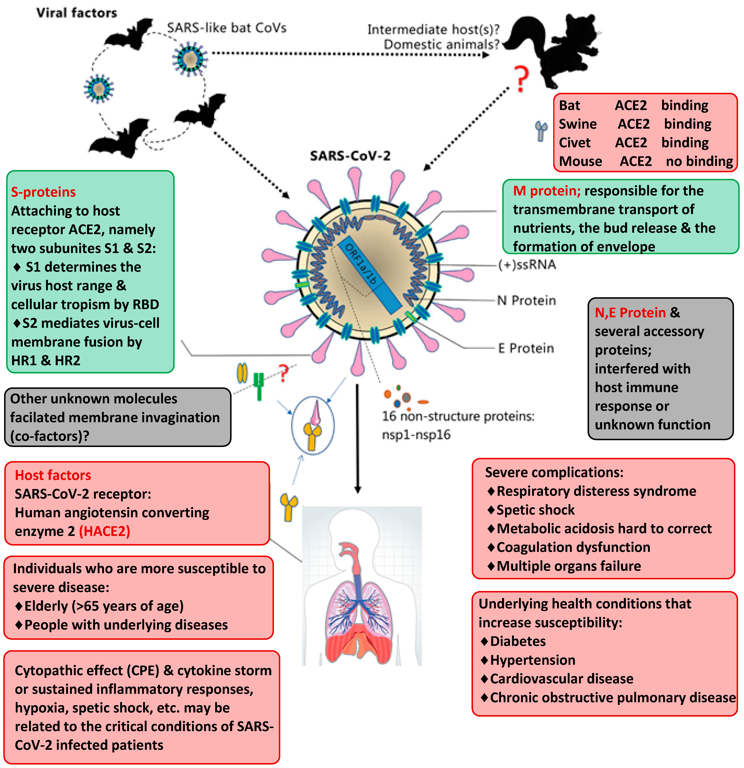
Highlights
•Several laboratory parameters may facilitate the assessment of COVID-19 severity
•Discriminating mild from severe COVID-19 disease
•Low lymphocyte count as well as the serum levels of CRP, D-dimers, ferritin and IL-6

Slide 3
COVID -19 laboratory parameters
While the clinical status (in particular SpO₂ levels) and C.T & concurrent comorbidities determine the need ICUs
Several laboratory parameters may facilitate the assessment of disease severity and rational triaging

Slide 4
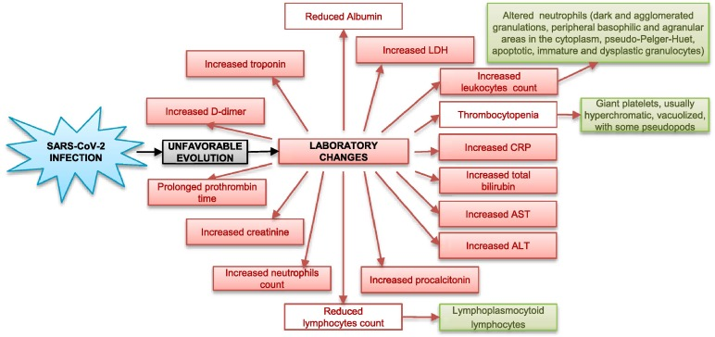
Laboratory changes in Covid -19

Slide 5
Hematological parameters
leukopenia with leukocyte count below 4 × 109 /L and
lymphopenia lymphocyte count lower than 1 × 109 / L is clearly associated with disease severity Repletion of lymphocytes may be an important factor for recovery (Henry, 2020)
Other blood cells–including white blood cells, neutrophils, eosinophils, platelets, were partial predictors in discriminating mild from severe COVID-19
Granulocyte colony stimulating factor (G-CSF) elevated in ICU patients significantly associated with disease severity

Slide 6
Hematological parameters
Decreased lymphocyte/leukocyte count ratio has already been reported indicating severe disease and/or fatal
Increased Neutrophil/lymphocyte(>3.3) and Neutrophil/Platelets ratio may be indicative of myocardial injury and increased mortality
Derived NLR ratio (d-NLR, neutrophil count divided by the result of WBC count minus neutrophil count),
Therefore, it is important to monitor the hematological parameters in order to try to assess the progression and prognosis of COVID-19

Slide 7
Increase in WBCs is driven by
Elevated neutrophils
Decreasing trends were observed for lymphocytes, monocytes , eosinophils.
Severe disease, a decrease in both CD4 and CD8 was observed.
With the SARS virus, it was suspected that lymphocytes are essential to
elimi-nating virally infected cells
while with COVID-19 it has been further hypothesized that survival may be dependent on ability to replenish lymphocytes which are killed by the virus
As such, lymphocyte count, espe-cially CD4, may serve as a clinical predictor of severity and prognosis

Slide 8
Causes of Significant reduction in lymphocytes
(a) Direct infection in these cells, causing their lysis by SARS-CoV-2, since lymphocytes have ACE2 receptors on the surface
(b) Possible lymphocyte apoptosis caused by the systemic inflammatory process with consequent large cytokines production
(c) Atrophy of lymphoid organs, such as the spleen, impairing lymphocyte turnover
(d) Lactic acidosis inhibiting lymphocyte proliferation, which is more evident in cancer patients, a risk group for COVID-19 complications (Terpos et al).

Slide 9
WBC morphologic abnormalities:
Regarding the lymphocytes morphological aspect, as reported by Fan et al,and Chng et al. reactive with lymphoplasmocytoid characteristics.
Presence of numerous dark and agglomerated granulations (similar to toxic granulations) and
Peripheral basophilic
Agranular areas in the cytoplasm
Grossly grouped chromatin in the nucleus
Pseudo-Pelger-Huet neutrophils
Apoptotic neutrophils;
Immature and dysplastic granulocytes, especially small myelocytes and metamyelocytes, as well as promyelocytes. Zini et al. .
Severe, transient and reversible myelopoiesis disorder, especially in accelerated and disordered granulopoiesis, in patients with severe symptomatic COVID-19.
cytokine “storm” and hyperinflammation, progression COVID-19 pneumonia, possibly as secondary hemophagocytic lymphohistiocytosis (HLH), MOF

Slide 10
Learning points
In peripheral blood film (PBF), neutrophils showed characteristic
C-shaped, fetus-like nuclei, elongated nucleoplasm, and ring-shaped nuclei.
Large granular lymphocytes noted, a representation of natural killer cells or cytotoxic T lymphocytes.
Activated monocytes indicated a favorable sign.
COVID-19 viral effects on leucocytes are associated with characteristic changes that can be readily identified on PBF and can be easily and serially monitored, which could help in the diagnosis, prognostication and treatment protocols.

Slide 11
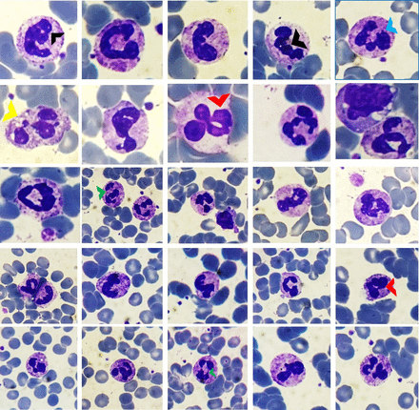
Peripheral blood films showing various neutrophils with C-shaped, fetus-like COVID nuclei (black arrowheads) with aberrant nuclear projections (blue arrowhead). Toxic granulations and vacuolations (yellow arrowhead), ring nuclei (red arrowheads) and elongated nucleoplasm (green arrowheads) are highlighted. Giemsa ×200–400.

Slide 12
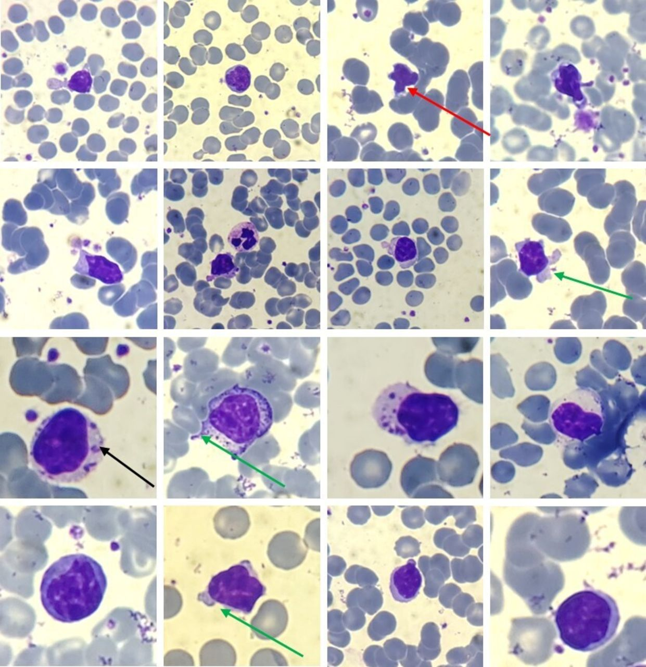
Peripheral blood films showing large granular lymphocytes. Round to indented nuclei, condensed chromatin, prominent nucleoli in a few, along with abundant pale blue cytoplasm with distinct variably sized azurophilic granules are present (long black arrow). Cytoplasmic pod formation (long green arrows) and apoptotic lymphocytes (long red arrow) are highlighted. Giemsa ×200–400.

Slide 13
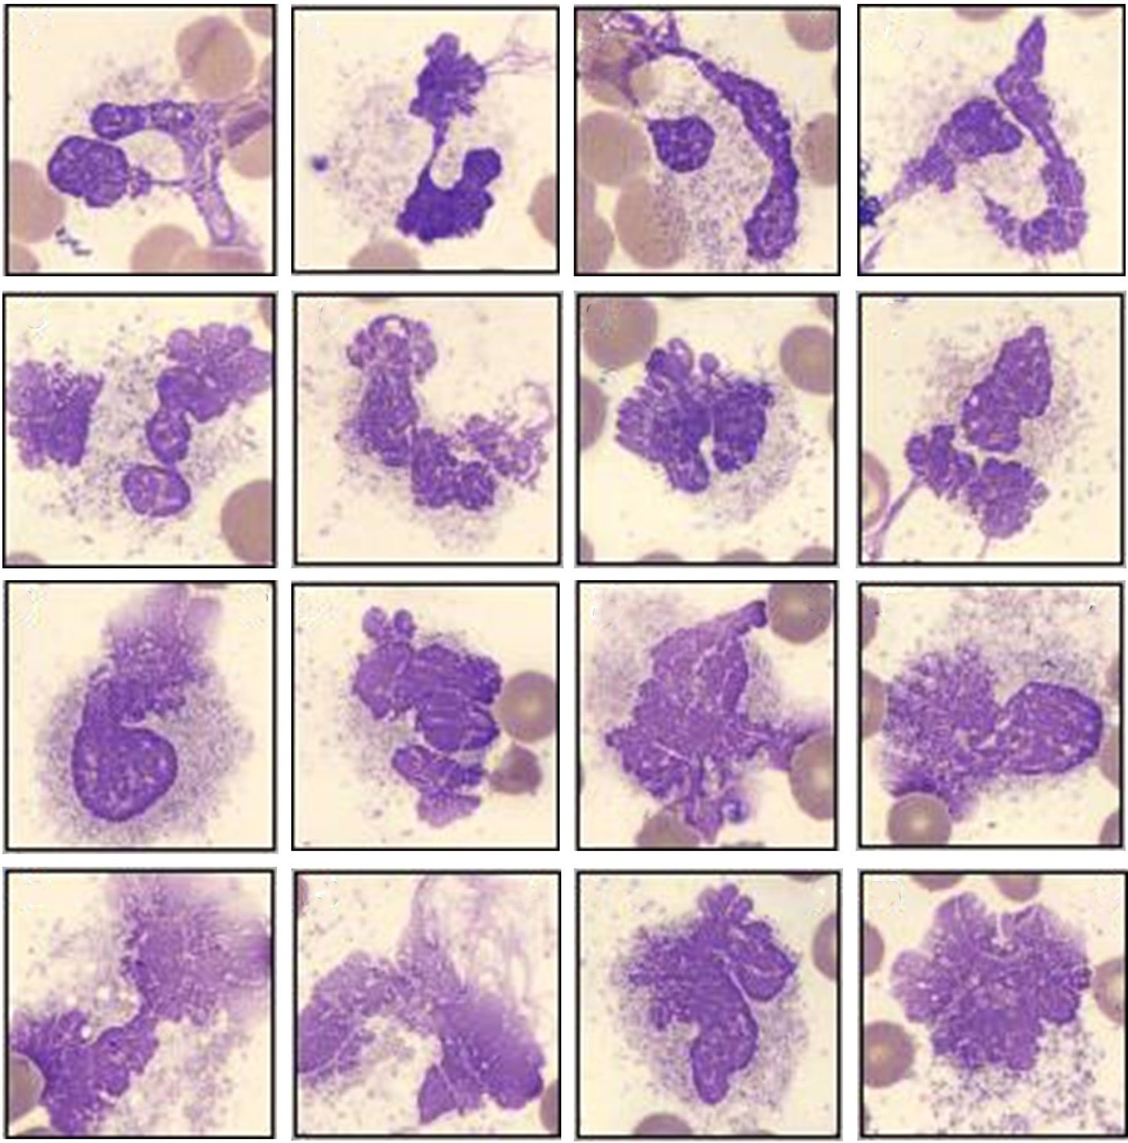
Increase in smudged granulocytes in the peripheral blood of patients with COVID-19

Slide 14
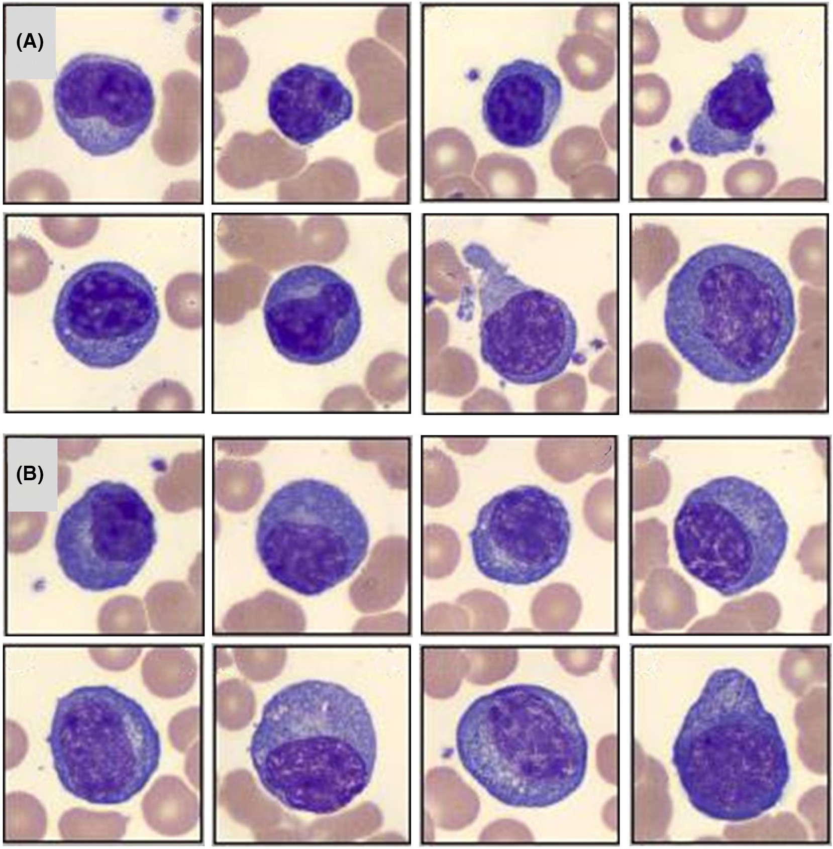
Spectrum of peripheral blood morphologic findings in patients with COVID-19 including (A) plasmacytoid lymphocytes and (B) plasma cell

Slide 15
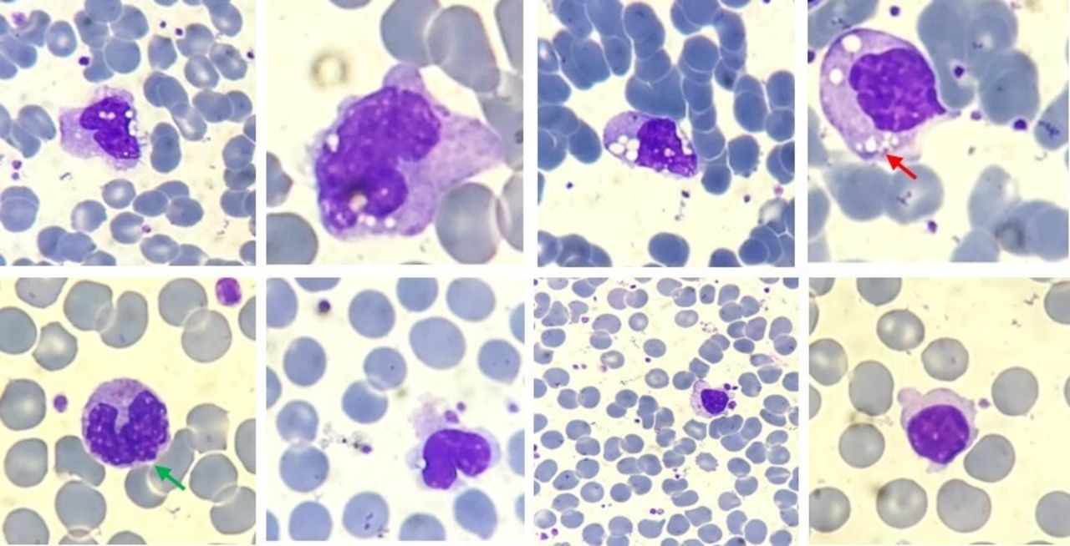
Peripheral blood films showing activated monocytes with prominent cytoplasmic vacuolisation and a few granules (small red arrow). Nuclear blebbing (small green arrow) is also seen. Giemsa ×200–400.

Slide 16
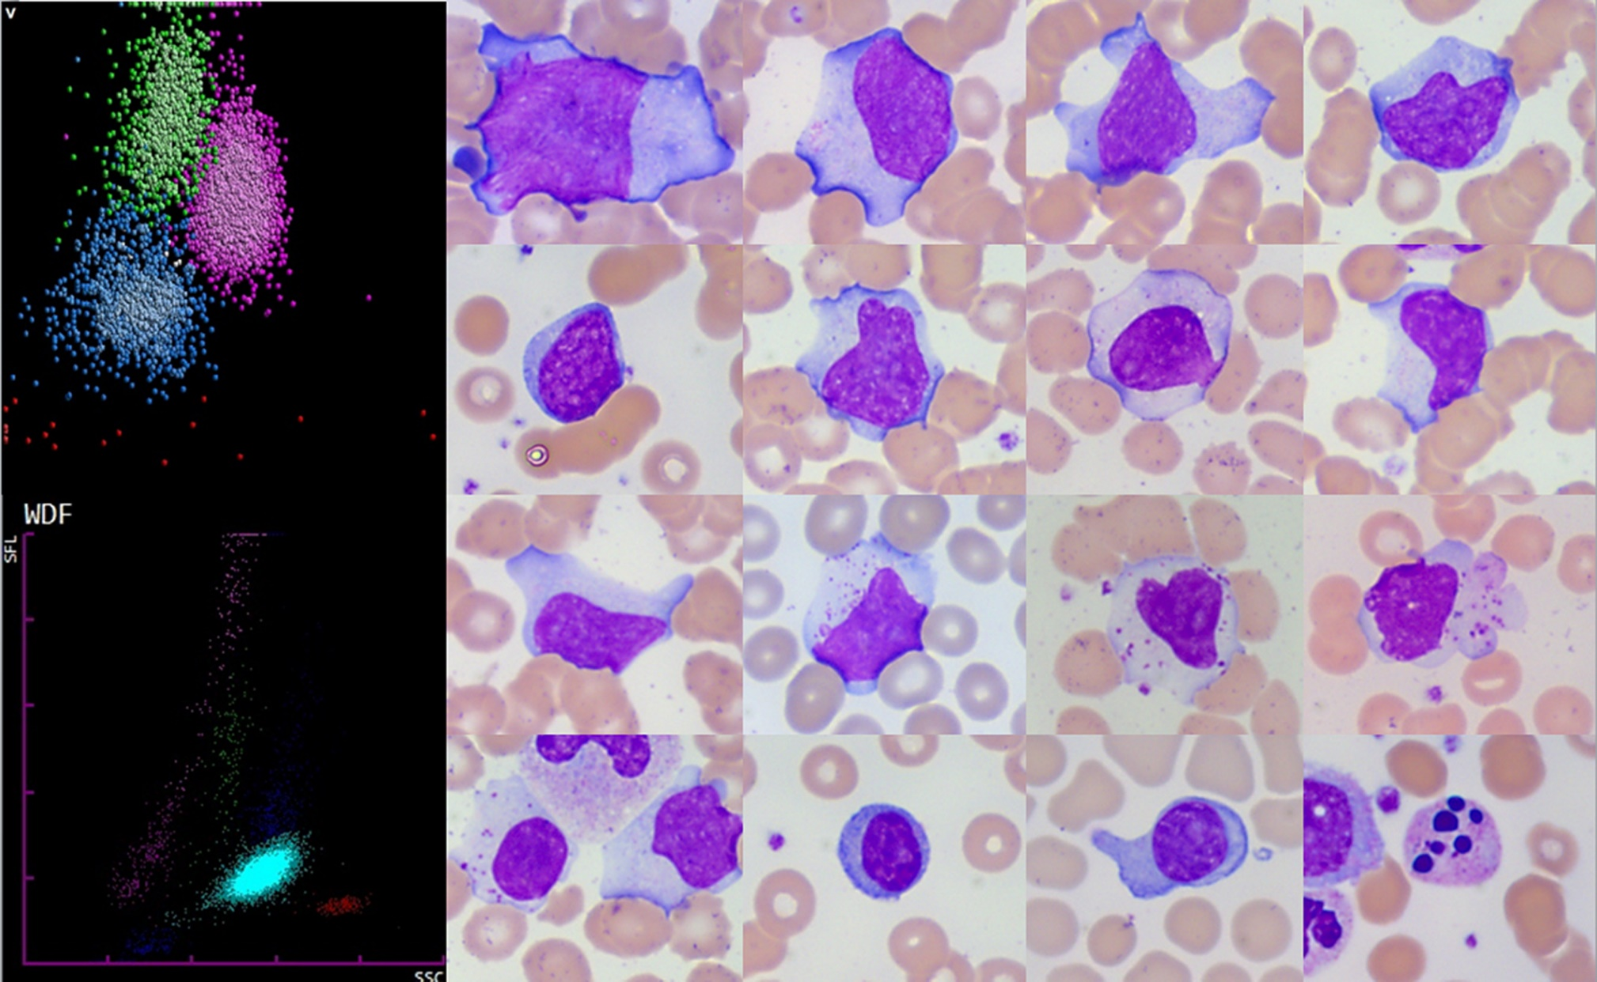
Covid -19 a new ethology for atypical lymphocytes

Slide 17
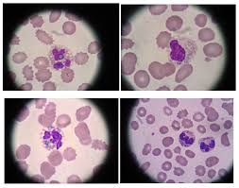
“green crystals of death” or “death crystals.”

Slide 18
Platelet morphology frequent anomalies
∆ Mainly in the presence of giant platelets,
Hyperchromatic
Vacuolized
Some showing pseudopods,
In patients with thrombocytosis also in those with thrombocytopenia

Slide 19
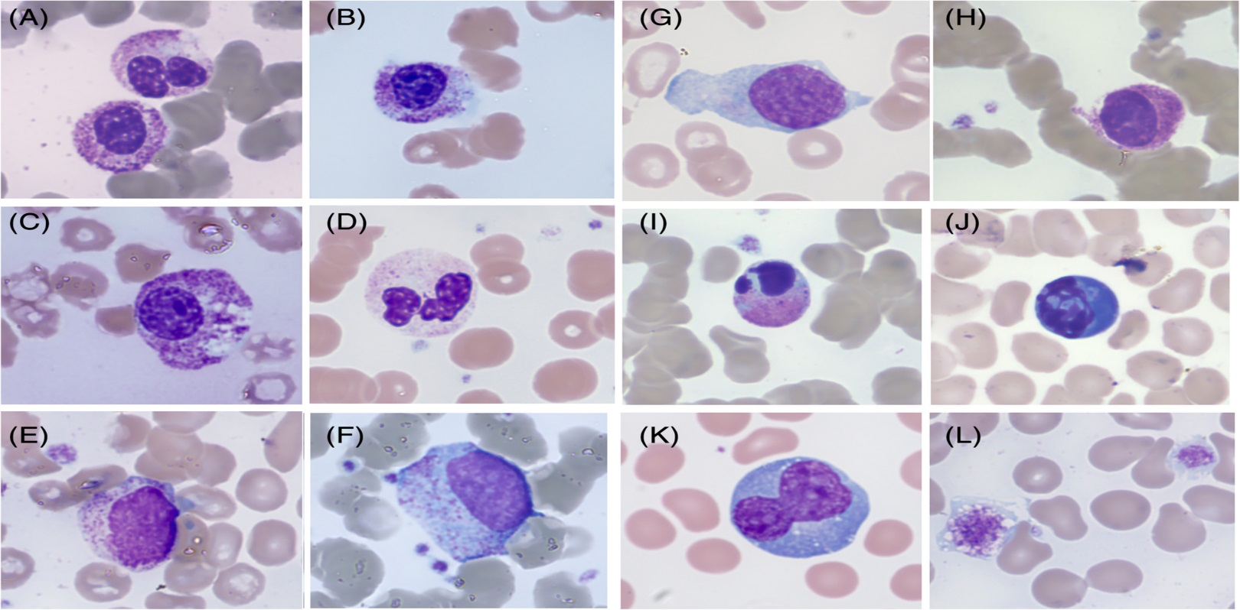
Morphological anomalies in peripheral blood films from different COVID-19 patients.
A, Neutrophil granulocytes with bilobed andunsegmented, pseudo-Pelgerlike nuclei.
B, Neutrophil granulocytes with unsegmented nucleus with coarsely clumped chromatin; cytoplasm ishypergranular with basophilic, agranular areas.
C, Unsegmented, hypergranular neutrophil with multiple vacuoles.
D, Neutrophil granulocyte with marked cytoplasmic hypogranularity.
E, Circulating small neutrophil myelocyte.
F, Circulating dysplastic promyelocyte (scattered azurophil granules,absence of paranuclear Golgi zone).
G, Immature circulating cell with blasts-like reticular chromatin and rare thin azurophilic granules.
H, Unsegmented granulocyte with hyperchromic nuclear chromatin and tightly condensed cytoplasm, likely pre-apoptotic.
I, Circulating apoptotic neutrophil.
J,Apoptotic cell with blue cytoplasm, of possible lymphocyte origin. K, Large polyploid reactive lymphocyte with hyperbasophilic cytoplasm.
L, Giantvacuolated platelet
American Journal of Hematology, Volume: 95, Issue: 7, Pages: 870-872, First published: 12 April 2020, DOI: (10.1002/ajh.25824)
Notes:
Morphological anomalies in peripheral blood films from different COVID‐19 patients. A, Neutrophil granulocytes with bilobed and unsegmented, pseudo‐Pelgerlike nuclei. B, Neutrophil granulocytes with unsegmented nucleus with coarsely clumped chromatin; cytoplasm is hypergranular with basophilic, agranular areas. C, Unsegmented, hypergranular neutrophil with multiple vacuoles. D, Neutrophil granulocyte with marked cytoplasmic hypogranularity. E, Circulating small neutrophil myelocyte. F, Circulating dysplastic promyelocyte (scattered azurophil granules, absence of paranuclear Golgi zone). G, Immature circulating cell with blasts‐like reticular chromatin and rare thin azurophilic granules. H, Unsegmented granulocyte with hyperchromic nuclear chromatin and tightly condensed cytoplasm, likely pre‐apoptotic. I, Circulating apoptotic neutrophil. J, Apoptotic cell with blue cytoplasm, of possible lymphocyte origin. K, Large polyploid reactive lymphocyte with hyperbasophilic cytoplasm. L, Giant vacuolated platelets
IF THIS IMAGE HAS BEEN PROVIDED BY OR IS OWNED BY A THIRD PARTY, AS INDICATED IN THE CAPTION LINE, THEN FURTHER PERMISSION MAY BE NEEDED BEFORE ANY FURTHER USE. PLEASE CONTACT WILEY'S PERMISSIONS DEPARTMENT ON PERMISSIONS@WILEY.COM OR USE THE RIGHTSLINK SERVICE BY CLICKING ON THE 'REQUEST PERMISSIONS' LINK ACCOMPANYING THIS ARTICLE. WILEY OR AUTHOR OWNED IMAGES MAY BE USED FOR NON-COMMERCIAL PURPOSES, SUBJECT TO PROPER CITATION OF THE ARTICLE, AUTHOR, AND PUBLISHER.

Slide 20
Red Blood Cell Distribution Width (RDW)
The Red Blood Cell Distribution Width (RDW) has been strongly associated with increased morbidity and mortality in multiple diseases.
Elevated RDW in hospitalized COVID-19 patients is associated with a significantly increased risk of mortality and septic shock

Slide 21
ABO Blood group and Covid-19 suceptibility
ABO blood group be incorporated into the variety of tests requested.
This recommendation is based on studies by Ellinghaus et al., 2020
Involvement of ABO blood groups in susceptibility to COVID-19.
Blood Blood group “O” is associated with a lower risk of infection by SARS-CoV-2
Blood group A was associated with a greater risk than those non-A

Slide 22
Cytokines induced by SARS-CoV-2
COVID-19 patients admitted to ICUs have been found to have higher concentrations of proinflammatory cytokines and, importantly, increased secretion of those T-helper-2 (Th2) cytokines suppressing inflammation (Huang et al., 2020
However, any intervention to reduce inflammation will negatively affect viral clearance.
Tumor necrosis factor alpha (TNF-α),
Interferon-γ-induced protein 10 (IP-10),
Monocyte chemoattractant protein 1 (MCP-1),
Chemokine (C-C motif),
ligand 3 (CCL-3),
Interleukins (IL) (IL-2, IL-6, IL-7, IL-10) were significantly associated with disease severity and particularly observed among cases admitted to ICUs

Slide 23
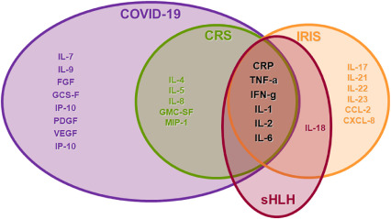
“Cytokines Storm,”in Covid -19
IRIS :Immunune Reconstitution Inflammatory Syndrome...
CRS :cytokine release syndrom
SHLH: secondary hemophogocytic lymphohistocytosis

Slide 24
The story behind IL-6 IL-10 in covid -19
The exaggerated elevation of inflammatory cytokines such as IL-6, which can lead to a so-called “cytokines storm,” may be a driver behind acute lung injury and ARDS and lead to other tissue damage progressing to MOF
. Additionally, elevated interleukin-10 (IL-10) was observed in patients with the severe form of the disease.
We suspect this may be related to compensatory anti-inflammatory response (CARS), which may be responsible for higher number of secondary infections (50%) and sepsis (100%) reported in non-survivors

Slide 25
Dysregulation of coagulation during COVID-19
P-selectin
fibrinogen
D-dimers
VWF
Depending on the direction, dysregulation of fibrin(ogen) D-dimer, VWF and P-selectin may result in either hypercoagulation or excessive bleeding and thrombocytopenia.
These are valuable biomarkers might assist in deciding the method of treatment
Heparin interferes with VWF platelet activation, and possibly assists in the prevention of thrombotic events

Slide 26
Abnormal coagulation parameters
Plasma D-dimers
Fibrin degradation products (FDP )
Increased PT
Increased APTT compared to survivors (Tang et al., 2020)
Coagulopathy and overt DIC appear to be associated with high mortality rates.
Among the coagulation parameters, D-dimer elevation > 1 ug/L
D-Dimer strongest independent predictor of mortality (Zhou et al., 2020)
Antiphospholipid antibodies,LA
According to Salamanna et al. (2020), these laboratory changes show an existing
Hypercoagulable state in critically ill favor the formation of
Micro thrombi in different organs, mainly in the lungs.
Damage to endothelial cells leads to over activation, Platelet aggregation

Slide 27
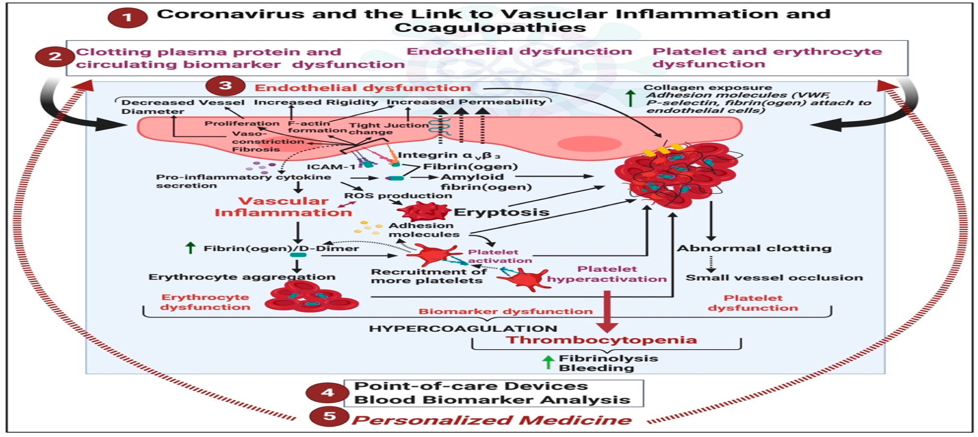
vascular implications of acute respiratory syndrome coronavirus 2 (COVID-19) (2) may result in clotting protein and circulating biomarker, endothelial, and erythrocyte and platelet dysfunctions. (3) We review the various biochemical processes associated with vascular dysfunction, focussing on fibrin(ogen), D-dimer, P-selectin and von Willebrand Factor. (4) We conclude by looking at point-of-care devices and methodologies in COVID-19 treatment and suggest that each patient should be treated using a (5) personalized medicine approach

Slide 28
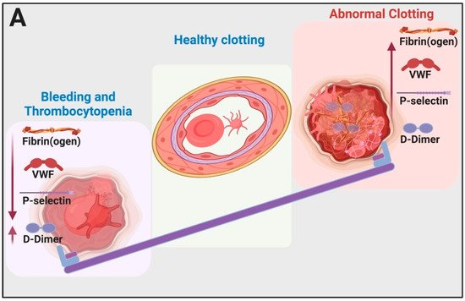
(A) Typical pathology in bleeding and clotting: the seesaw balancing act between bleeding and thrombocytopenia and hypercoagulation. This image was created with BioRender (https://biorender.com/).

Slide 29
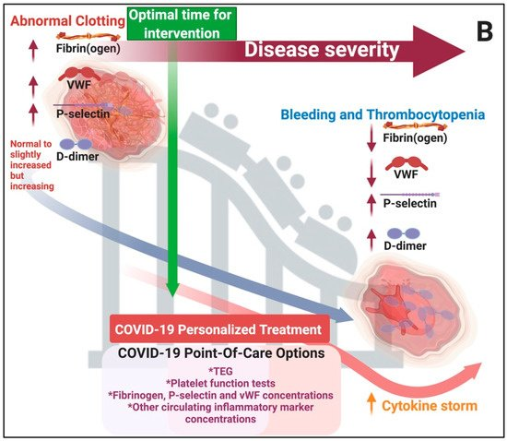
B) Clinical manifestation of hypercoagulation, thrombocytopenia and bleeding during COVID-19 as well as clinical care options and optimal time for intervention: During the early stages of abnormal clotting, D-dimer levels are normal or slightly increased but will increase rapidly with progression of the disease (clinical observation). This image was created with BioRender (https://biorender.com/)

Slide 30
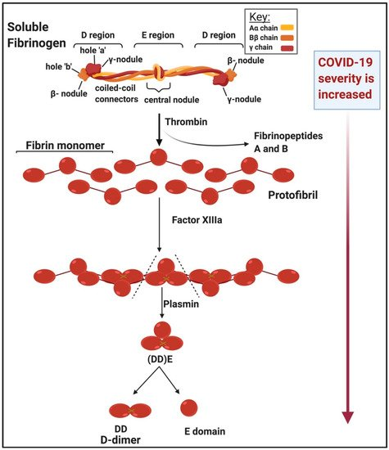
Structure of soluble versus insoluble fibrin(ogen) and the action of thrombin and D-dimer formation D-dimer levels are increased in very ill patients (clinical observation).

Slide 31
Personalised medicine in COVID-19 patients
P.M has been so important as during this epidemic.
Point-of-care devices and diagnostics like the thromboelastograph (TEG) (that gives an indication of fibrinogen levels) or
Point-of-care ultrasound (POCUS) allows for frequent
Testing of the coagulation/bleeding profiles
As well as blood clot fibrinolysis of patients at the bedside
TEG is particularly useful to also assess fibrinolysis,
The TEG can also predict thromboembolic events in critically ill patients with COVID-19

Slide 32
How clinicians should approach
Most importantly, we need clinicians to have access to adequate point-of-care devices and encourage them to use parameters of hemostasis Fibrinogen, D-dimer and VWF levels
Determine if patients are in need of either therapeutic antithrombotic prophylaxis/treatment
Fibrinolytic therapy to prevent whichever coagulopathy is present,
Hypercoagulation, fibrinolysis shutdown or bleeding.
Most significant is that patients need to be treated early in the disease progression when high levels of VWF, P-selectin and fibrinogen are present with still low levels of D-dimer.
Progression to VWF and fibrinogen depletion with high D-dimer levels and even higher P-selectin levels, followed by the cytokine storm, will be indicative of a poor prognosis.

Slide 33
WHAT IS TEG?
Thromboelastography (TEG) measures the dynamics of clot development, stabilization/strength, and dissolution. Assuming the body’s ability to achieve hemostasis is a function of these clot properties, TEG provides specific, real-time indicators of a patient’s in vitro hemostatic state. This is in contrast to routine screening coagulation tests such as aPTT and PT/INR which are run with blood plasma alone and therefore do not take into account the cellular components of clotting.
HOW TO READ A TEG
TEG creates a graphical representation of the movement of a small pin suspended in a cup of whole blood as hemostatsis occurs. As the blood begins to clot and adhere to the pin, the movement of the pin increases. This increasing movement is interpreted by the computer as increasing amplitude on the TEG graph.

Slide 34
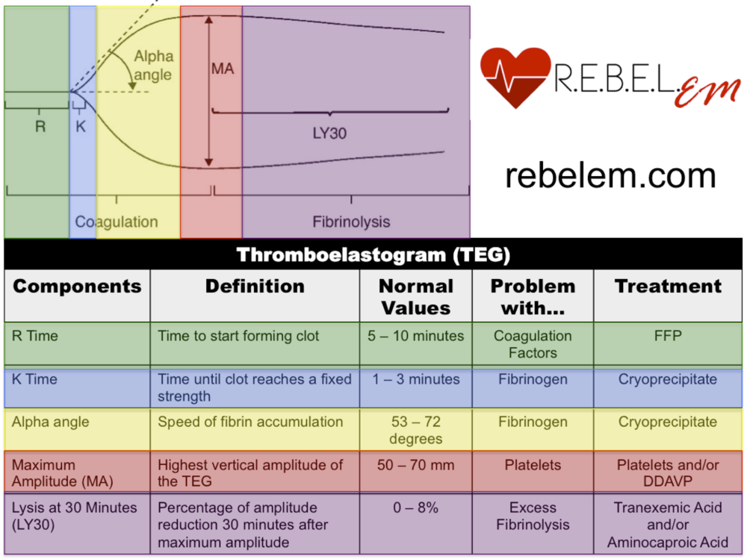
Thromboelastography (TEG) in Covid-19

Slide 35
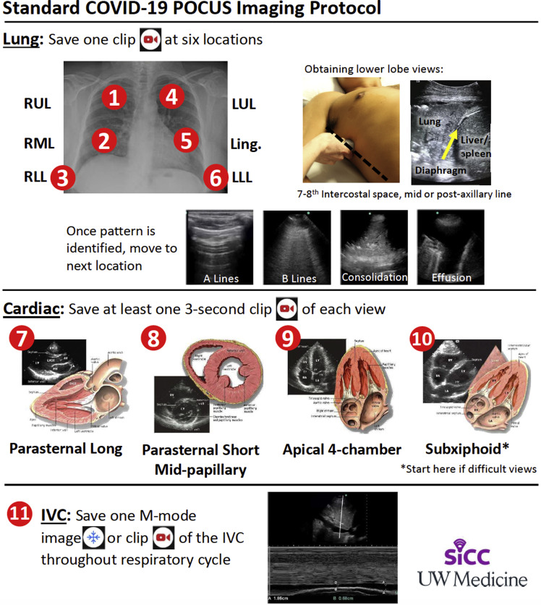
POCUS in Covid -19

Slide 36
Laboratory signs of liver dysfunction
Patients with severe COVID-19 appear to have more frequent signs of liver dysfunction than those with milder disease.
An increase in alanine aminotransferase (ALT), aspartate aminotransferase (AST) and total bilirubin levels has been observed among many ICU patients (Zhang et al., 2020a)
Infection of liver cells with SARS-CoV-2 cannot be excluded as 2–10% of patients with COVID-19 have diarrhea and viral RNA has been detected in both stool and blood samples, which implies the possibility of hepatic virus presence (Yeo et al., 2020)
immune-mediated inflammation, in particular cytokine storm, pneumonia-associated hypoxia, may lead to liver damage in critically ill COVID-19 patients (Zhang et al., 2020a)

Slide 37
C-reactive protein (CRP),ESR,Procalcitonin
Inflamation & sepsis predictors
C-reactive protein (CRP) levels are increased in COVID-19 patients and it has been shown that survivors had median CRP values of approximately 40 mg/L,
Point to development of a systemic inflammatory response syndrome (SIRS)
While non-survivors had median values of 125 mg/L,
Indicating a strong correlation with disease severity and prognosis (Ruan et al., 2020)
Increased ESR
Increased Procalcitonin in secondary bacterial infection

Slide 38
Other predictors of poor outcome
Serum levels of ferritin
lactate dehydrogenase (LDH).
Elevated ferritin levels due to :
Secondary haemophagocytic lymphohistiocytosis (sHLH)
Cytokine storm syndrome have been reported in severe COVID-19 patients.
Based on body temperature, organomegaly, blood cell cytopenia, triglycerides, fibrinogen, AST and ferritin levels, a predictive H-score has been proposed to estimate the risk of developing( HLHs) (Mehta et al., 2020)

Slide 39
Angiotensin-converting enzyme polymorphism (ACE):
“The angiotensin-converting 1 (ACE1) enzyme is characterized by a genetic deletion/insertion (D/I) polymorphism in intron 16, alterations in circulating ,tissue concentrations of ACE,”
Differences in COVID-19 among continental European countries might in part be due to D/I genotype distribution variability.
Comparing 25 European countries COVID-19 prevalence and mortality, the a correlation between prevalence of COVID-19 and ACE D allele frequency.
Frequency of the ACE1 D-allele 38% of the variability of disease prevalence,
“ACE1 D/I polymorphism may be regarded as a confounder in the spread of COVID-19 and the outcome of the infection in various European populations.”

Slide 40
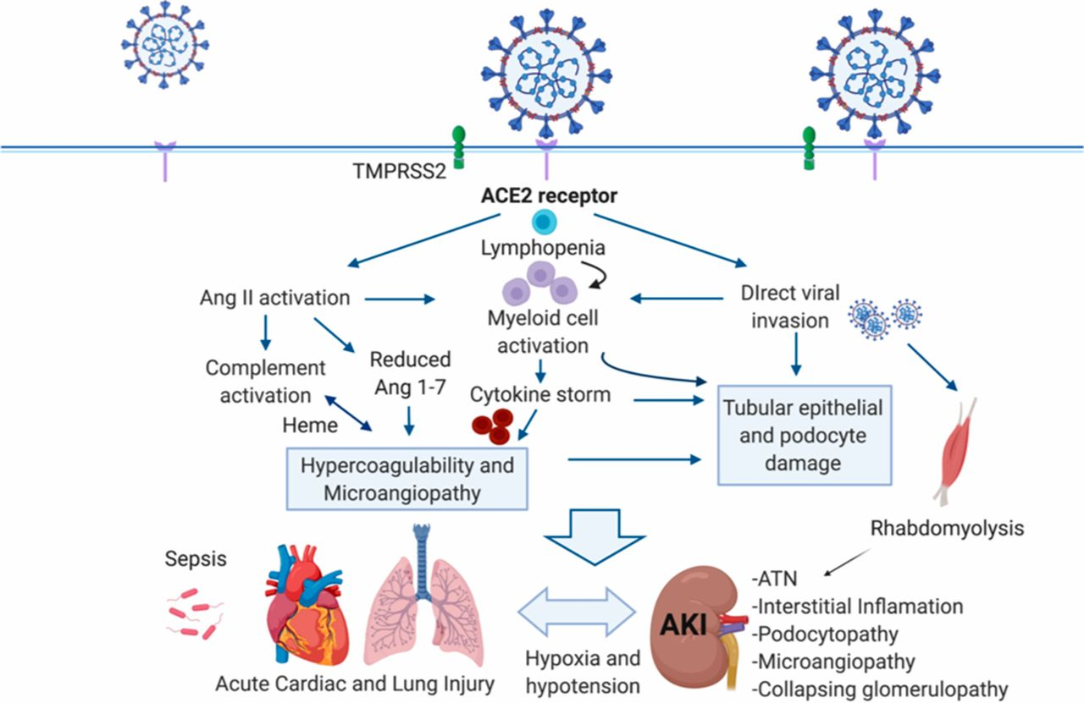

Targeting of ACE2 by SARS-CoV-2 results in angiotensin dysregulation, innate and adaptive immune pathway activation, and hypercoagulation to result in organ injury and AKI associated with COVID-19.
Daniel Batlle et al. JASN 2020;31:1380-1383
©2020 by American Society of Nephrology
Notes:
Targeting of ACE2 by SARS-CoV-2 results in angiotensin dysregulation, innate and adaptive immune pathway activation, and hypercoagulation to result in organ injury and AKI associated with COVID-19. Organ crosstalk between the injured lungs, the heart, and the kidney may further propagate injury. CD8⁺ T-cells and natural killer cells can restrain macrophage activation and are potential targets for SARS-CoV-2. Ang 1–7, angiotensin 1–7; ATN, acute tubular necrosis. ACE2, angiotensin converting enzyme 2; SARS-CoV-2, severe acute respiratory syndrome coronavirus 2; TMPRSS2, transmembrane protease, serine 2.

Slide 41
Abnormal troponin
Given the frequency and nonspecific nature of results among patients with COVID-19 infection
Clinicians are advised to only measure troponin if the diagnosis of acute myocardial injury
Being considered on clinical grounds, and an abnormal troponin should not be considered evidence for an acute MI without corroborating evidence,” similar for BNP or NT-proBNP.
Elevated cardiac troponin I levels indicating heart injury(Cardiomyopathy) were also predictive of mortality in critically ill patients (Lippi et al., 2020
Wang et al., 2020a

Slide 42
Multiorgan failure (MOF)
Biomarkers of cardiac and muscle injury were elevated in patients with both severe and fatal COVID-19.
Patients who died had significantly elevated cardiac troponin levels at presentation 32.7 ng/L), thus suggesting potential for viral myocarditis,
Cardiac injury from progression towards multiple organ failure (MOF), as well as secondary cardiac injury from organ targeted pathologies (e.g. renal or liver failure).
Combined with significant elevations in liver enzymes (alanine aminotransferase and aspartate aminotransferase), renal biomarkers (blood urea nitrogen, creatinine), and coagulation measures,
MOF becomes very apparent in patients who develop the severe form of the disease, even withithin laboratory parameters measured primarily at admission.

Slide 43
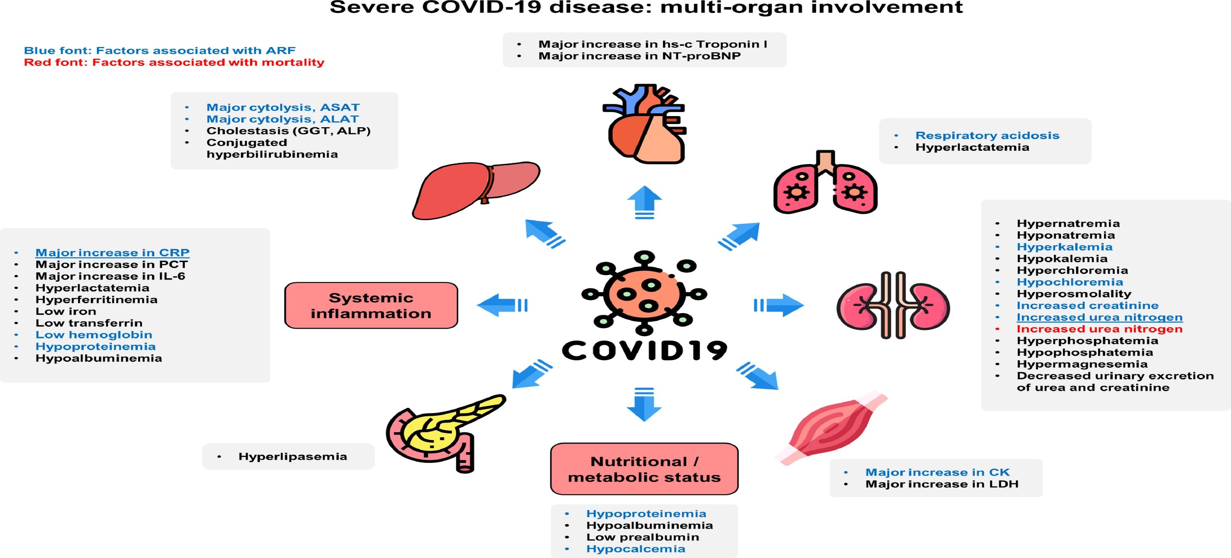
Fig. 6
EClinicalMedicine DOI: (10.1016/j.eclinm.2020.100554)
Copyright © 2020 The Author(s) Terms and Conditions
Notes:
Overview of the evolution of the main biochemical abnormalities and potential predictors acute respiratory failure (ARF) or in-hospital mortality among patients with severe COVID-19. Predictors of ARF in bivariate analyses are highlighted in blue font. Predictors of COVID-19 related mortality in bivariate analyses are highlighted in red font. Independent predictors of ARF in the multivariable multilevel analysis are underlined. ALP: alkaline phosphatase; ASAT: aspartate aminotransferases; ALAT: alanine aminotransferases; CK: creatine kinase; CRP: C-reactive protein; GGT: γ-glutamyltransferase; hs-c Troponin l: high-sensitivity cardiac troponin I; IL-6: interleukin 6; LDH: lactate dehydrogenase; NT-pro-BNP: N-Terminal pro-Brain Natriuretic Peptide; PCT: procalcitonin; (icons made by flaticon, flaticon.com; CC-BY-3.0).

Slide 44
Secondary haemophagocytic lymphohistiocytosis (sHLH),
less recognized entity, most commonly triggered by viral infections.
sHLH is hyper inflammatory syndrome characterized by a fulminant and fatal hyper cytokinaemia with multiorgan failure.
Occurring in around 3.7-4.3% of sepsis, it is clinically suspected in sepsis cases presenting with
unremitting fever, cytopenias ,hyper ferritinemia; pulmonary involvement (including ARDS) occurs in approximately 50% of patients.
As sHLH and cytokine storm syndrome have a similar clinical and laboratory findings

Slide 45
Secondary haemophagocytic lymphohistiocytosis (sHLH),
(HLH) is a severe, life-threatening inflammatory syndrome
aberrant activation of T cells,
natural killer (NK) cells,
and macrophages
intense cytokine release (also known as a “cytokine storm”).
HLH is characterized by aggressive course leading to multi-organ failure.

Slide 46
Secondary haemophagocytic lymphohistiocytosis (sHLH),
Secondary HLH (which can be triggered by infections, malignancies, Rheumatological diseases, or autoimmune/immunodeficiency conditions).
The pathogenesis of SARS-CoV-2 infection also suggests that HLH or a similar hyperinflammatory syndrome is the cause of the severe course of the infection.
This excessive auto inflammatory response leads to rapidly progressing multi-organ failure
Bone marrow biopsy, when available, is necessary, since hemophagocytosis in the bone marrow may support the therapy when present
specifc markers for HLH:
sCD25 as a marker of T cell activation
sCD163 as the marker of hemophagocytosis

Slide 47
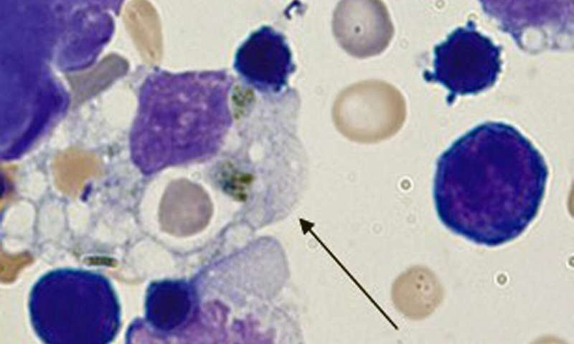
sHLH (hemophagocytic lymphohistiocytosis) may play a key role in saving lives during the COVID-19 virus pandemic.

Slide 48
Conditions causing HLH
Autoimmune/immunodeficiency conditions
Epstein-Barr virus (EBV)
Herpes simplex virus (HSV) infections are the most frequent triggers of sHLH,
Although other viruses (e.g., cytomegalovirus, hepatitis A, parvovirus B19, adenovirus, influenza) and pathogens (e.g., bacteria, fungi, parasites) have also been implicated.
it may be triggered by SARS-CoV-2, which could explain the rapid disease progression observed in some patients

Slide 49
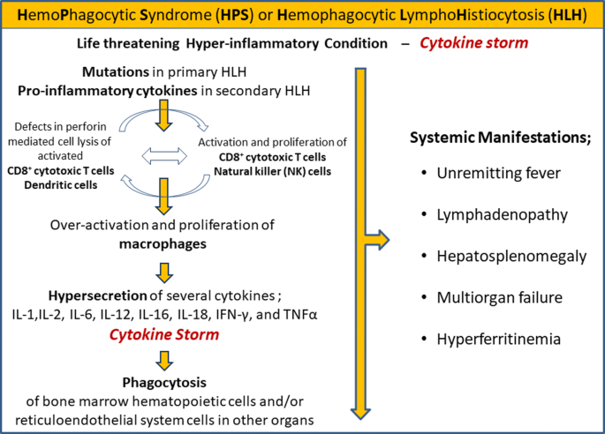

Slide 50
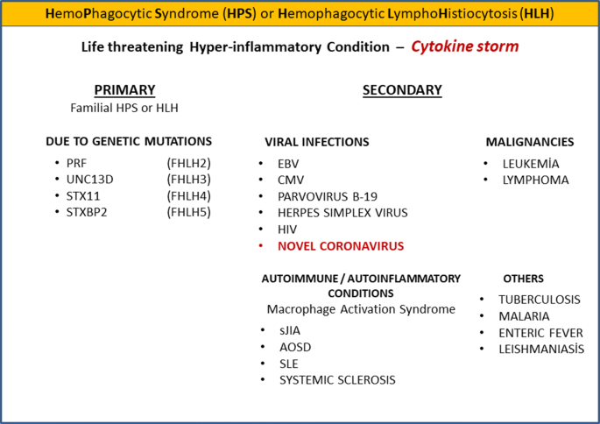

Slide 51
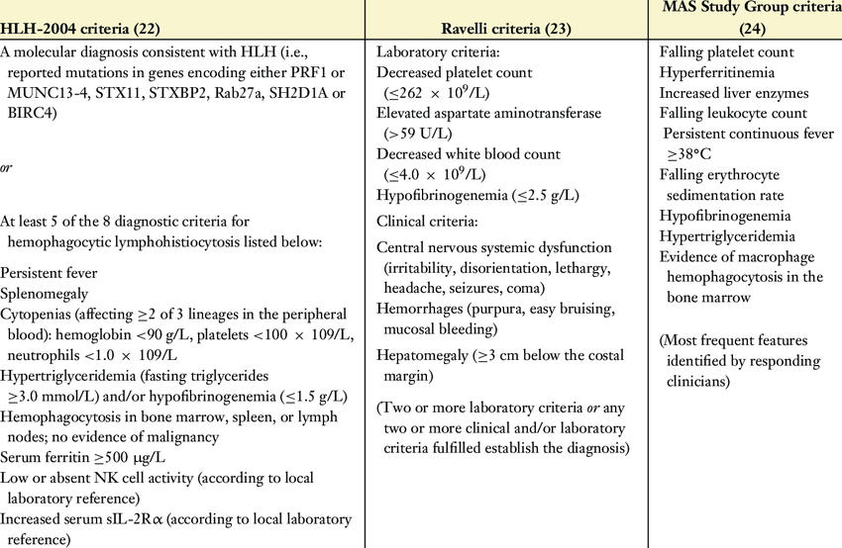

Slide 52
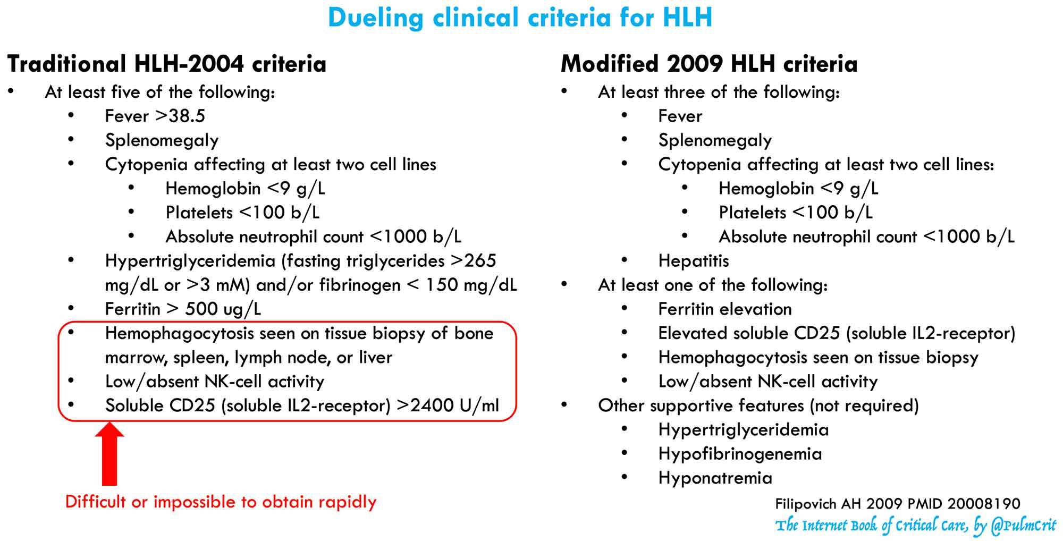

Slide 53
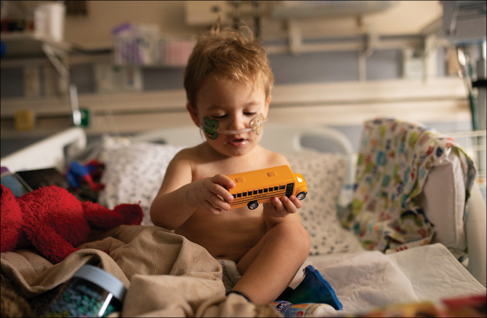
Covid in children

Slide 54
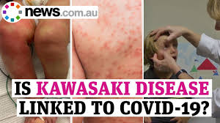

Slide 55
Kawasaki disease in children
First, the degree to which children transmit COVID-19 is key to how countries reopen communities after lockdown.
Kawasaki disease is a rare acute paediatric vasculitis, with coronary artery aneurysms as its main complication.
The diagnosis is based on the presence of persistent fever, exanthema, lymphadenopathy, conjunctival injection, and changes to the mucosae and extremities.
These differences raise the question as to whether this cluster is Kawasaki disease with SARS-CoV-2 as the triggering agent, or represents an emerging Kawasaki-like disease characterised by multisystem inflammation. Lancet 06 june

Slide 56
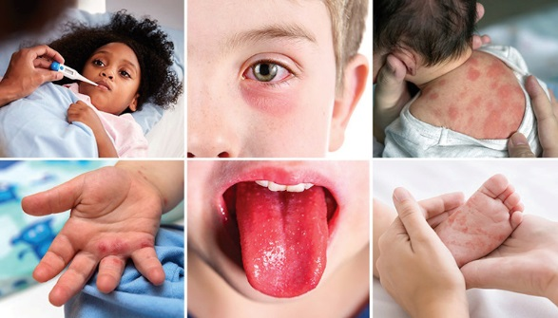
Kawasaki disease (KD)

Slide 57
Kawasaki disease (KD)
Self-limiting systemic inflammatory disease that occurs predominantly in children younger than 5 years of age.
Clinical manifestations of KD include
Prolonged fever (1-2 weeks, mean 10-11 days), conjunctival injection, oral lesions, polymorphous skin rashes, extremity changes, and cervical lymph adenopathy arthritis, aseptic meningitis, anterior uveitis, gall bladder hydrops, urethritis and lung involvement
Some more severely affected patients show cardiac complications, particularly coronary artery lesions (CALs) such as aneurysms and ectasias, which develop in approximately one quarter of untreated children and 5-10% of intravenous immunoglobulin (IVIG) treated children.

Slide 58
Summary of laboratory changes in patients with severe or fatal COVID-19.
↑ Creatinine ↑ Creatine kinase ↑ Lactate dehydrogenase ↑ Myoglobin ↑ Creatine kinase-MB ↑ Cardiac troponin I Coagulation ↑ Prothrombin time ↑ D-dimer Inflammatory biomarkers ↑ Erythrocyte sedimentation rate ↑ CRP ↑ Serum ferritin ↑ PCT ↑ IL-2R ↑ IL-6 ↑ IL-8 ↑ IL-10
Hematologic
↑ WBC count
↑ Neutrophil count
↓ Lymphocyte count
↓ Platelet count
↓ Eosinophil count
↓ Hemoglobin
Biochemical
↓ Albumin
↑ Alanine aminotransferase
↑ Aspartate aminotransferase
↑ Total bilirubin
↑ Blood urea nitrogen

Slide 59
Unfavorable parameters Clinicians should consider
low lymphocyte count
Serum levels of CRP,
D-dimers,
Ferritin,
Cardiac troponin
IL-6,
which may be used in risk stratification to predict severe and fatal
COVID-19 in hospitalized patients.

Slide 60
Last But Not Least
Finally, still in the laboratory context, it is essential that good clinical laboratory and biosafety practices prevail and that the patient be the center of attention.
Additional training of laboratory personnel responsible for collecting, transporting and handling biological samples and carrying out the various laboratory tests for patients with COVID19 is recommended.
Training for new demands and development of skills in data interpretation are also required, as well as cooperation and collaboration among laboratory professionals.
In today's challenging times, more than ever, the clinical laboratory needs to be patient-centered and with qualified leadership to be safe, efficient, effective and timely

Slide 61


Slide 62


