Slide 1
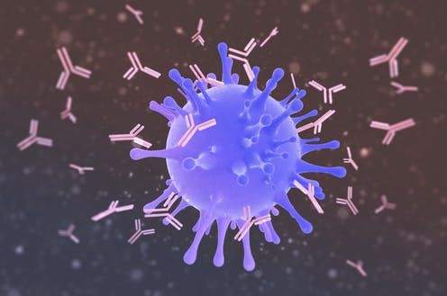


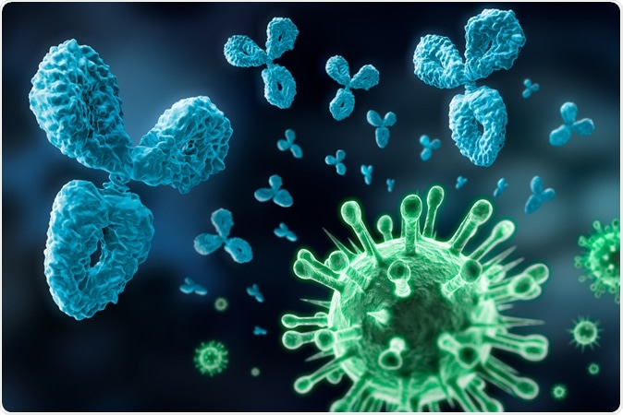
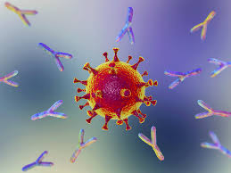



COVID-19 Serology
Dr.S.Hosseini (DCLS)
Aliasghar Children Hospital
Iran University of Medical science
1399.12.3

Slide 2
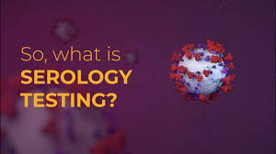
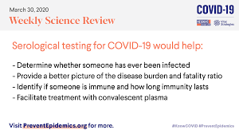

Slide 3
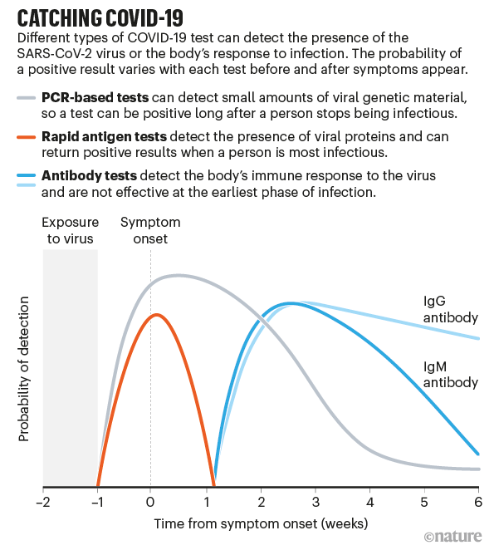

Slide 4
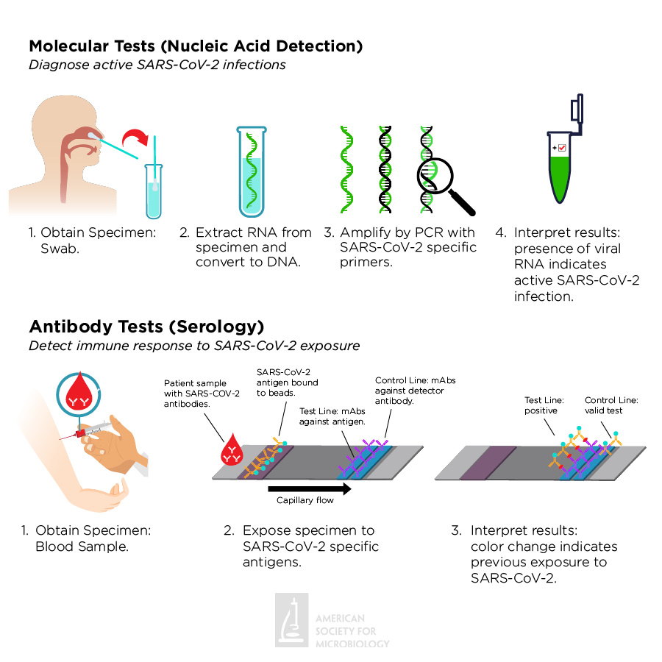

Slide 5
The COVID-19 pandemic
Now less than a year old, has brought into sharp focus inequalities within and among countries.
“The collapse of Global cooperation and a failure of international solidarity have pushed low-income and middle-income countries (LMICs) out of the diagnostics market”.

Slide 6
Why are diagnostics important?
In any epidemic response, diagnostic testing plays a crucial role ,this pandemic is no exception.
Because early clinical presentations of infected patients are non-specific
Testing is needed to confirm the diagnosis of COVID-19 in symptomatic patients
Patients be appropriately isolated and clinically managed.

Slide 7
Why are diagnostics important?
Diagnostic testing is also needed for individuals who have come into contact with some one with confirmed COVID-19.
Some testing strategies examine only contacts who have symptoms or develop illness of any kind during the 14-day period after contact.
Other strategies examine all contacts when identified, regardless of whether they have any symptoms.

Slide 8
Why are diagnostics important?
Studies have shown that a large number of infected individuals might have no symptoms at all
Pre sympthomatic, pausi symptomatic are still able to shed the virus and transmit infection through saliva droplets as they speak or air molecules
Tracking all contacts of confirmed cases and testing them for severe acute respiratory syndrome coronavirus 2 (SARS-CoV-2) is key to successful pandemic control

Slide 9
Why are diagnostics important?
Diagnostics are also needed to support rapid sero surveys that establish whether and to what extent SARS-CoV-2 has circulated in a community
Surveillance systems, such as that for influenza-like illness, that monitor disease trends over time.
Diagnostics can also be used to identify at risk populations and assess the effectiveness of control strategies

Slide 10
Immune response to COVID-19 disease
Maturation of the immune response typically takes 40 -60 days with variations in the dynamics of the antibody response depending on disease severity and other factors still to be discovered.
In most studies of laboratory confirmed COVID-19 cases, IgM antibodies start to be detectable around 5–10 days after onset of symptoms and rise rapidly.
IgG antibody concentrations follow the IgM response closely.
Seroconversion is typically within the first 3 weeks with the mean time for seroconversion being 9–11 days after onset of symptoms for total antibody, 10–12 days for IgM, and 12–14 days for IgG.

Slide 11
There are four major types of serological diagnostic tests:
Rapid diagnostic test (RDT)
Enzyme-linked immunosorbent assay (ELISA),
Chemiluminescence immunoassay (CLIA)
Neutralization assay.

Slide 12
Point-of-care (POC) tests
Generally are lateral flow devices that detect IgG, IgG and IgM, or total antibody in serum, plasma, whole blood, and/or saliva.
An advantage of some point-of-care tests using whole blood is that they can be performed on blood samples obtained by fingerstick rather than venipuncture

Slide 13
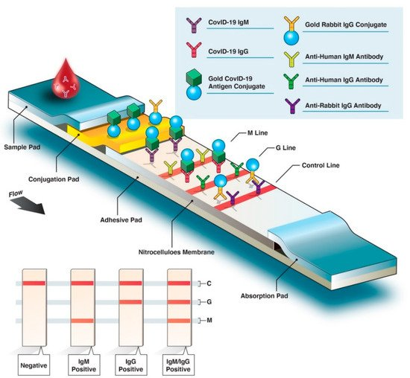
Figure 2. Overview of rapid diagnostic serological test. Rapid diagnostic tests (RDTs) are typically based on colorimetric lateral flow immunoassay, in which host antibodies migrate across an adhesive pad (e.g., nitrocellulose) and interact with bound virus-specific antigens and secondary antibodies (antihuman IgM/G antibodies). Conjugated SARS-CoV-2-specific antigen(s) (labeled with gold here) will bind with the corresponding host antibodies. As antibody–antigen complexes travel up the membrane, bound anti-SARS-CoV-2 IgM antibodies interact with fixed anti-IgM secondary antibodies on the M line, and anti-SARS-CoV-2 IgG antibodies interact with anti-IgG antibodies on the G line. If the blood sample does not contain SARS-CoV-2-specific antibodies, the M or G lines do not appear in the final test results; only the control (C) line will be revealed.

Slide 14
Types of Antibody Testing
Different types of assays can be used to determine different aspects of immune response and functionality of antibodies. The tests can be broadly classified to detect either binding or neutralizing antibodies.
Binding antibody detection: These tests use purified proteins of SARS-CoV-2, not live virus, and can be performed in lower biosafety level laboratories (e.g., BSL-2). With specific reagents, individual antibody types, like IgG, IgM, and IgA, can be determined. Although scientists do not know how long antibodies to SARS-CoV-2 can be detected, for most other infections,
IgM is most useful for determining recent infection as it usually becomes undetectable weeks to months following infection,
while IgG may remain detectable for months or years. (3-5mnth)
IgA is important for mucosal immunity and can be detected in mucous secretions like saliva in addition to blood, though its significance in this disease is still to be determined.
Depending on the complexity of assays, these tests can be performed rapidly (in less than 30 minutes) in a field setting or in a few hours in a laboratory.
Tests that detect binding antibodies fall into two broad categories.

Slide 15
ELISA assay
, currently the most commonly used format of the serological test, is a lab-based test with an average time-to-result of 2–5 h.
ELISA typically uses a surface coated with specific viral antigen(s) to bind to and detect the corresponding patient antibodies (IgG, IgM, IgA) in blood, plasma, or serum samples.
The bound antigen–antibody complex is then detected by using a second antibody and a substrate that produces a color- or fluorescent-based signal. ELISA assays can be found in different formats including direct, competitive, and, the most commonly used, sandwich or double-antigen-bridging assay (DABA) (Figure 3).

Slide 16
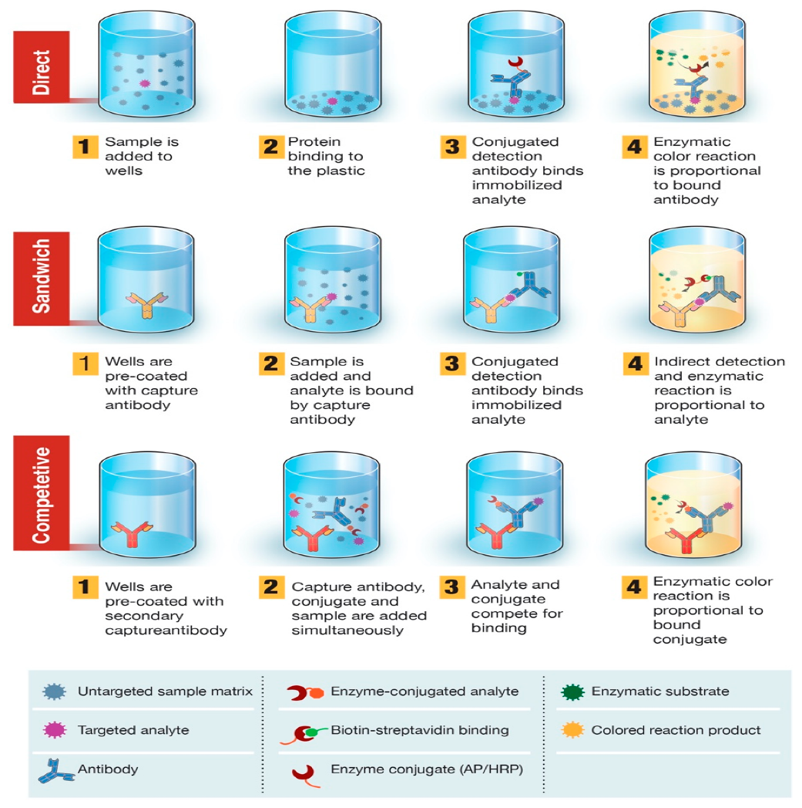
Figure 3. Overview of enzyme-linked immunosorbent assay (ELISA)-based diagnostic test. ELISA can be presented in different formats based on differences in antigen immobilization and antibody labeling. In direct ELISA, SARS-CoV-2 antigen(s) bound to a plastic solid phase is detected by the addition of a conjugated antibody. In sandwich ELISA, the capture antibody is attached to the plastic solid phase. Antigen(s) in the sample will bind to the capture antibody and then be detected by a second enzyme-labeled antibody. In competitive ELISA, sample SARS-CoV-2 antigen is preincubated with the primary antibody and then added to a well coated with a secondary antibody along with an enzyme-conjugated antigen that competes with the sample antigen for binding with the primary antibody. The more SARS-CoV-2 antigen in the sample, the less conjugated antigen will be bound and the lower the signal will be

Slide 17
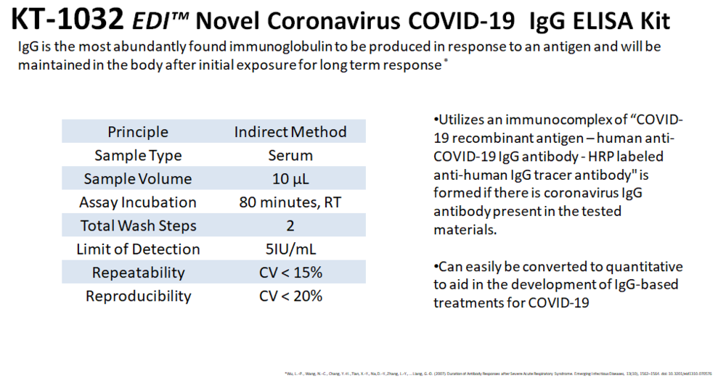

Slide 18
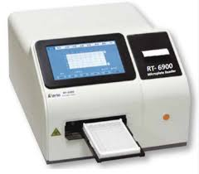
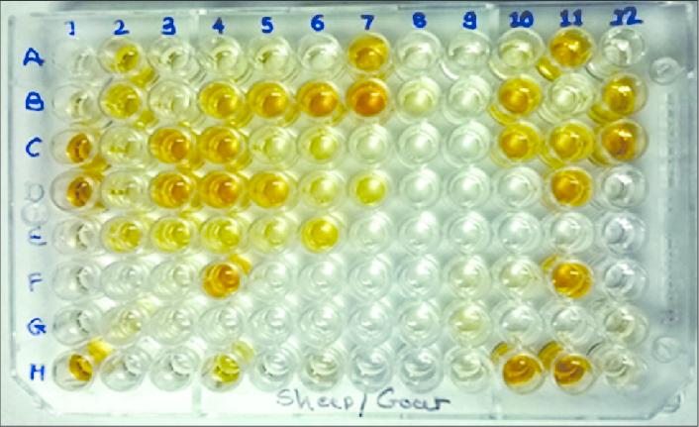
ELISA MACHINE

Slide 19
CLIA technology
follows a similar concept to ELISA by taking advantage of high binding affinity between the viral antigen(s) and host antibodies but uses chemical probes that yield light emission through a chemical reaction to generate a positive signal.
CLIA has an average time-to-result of 1–2 h. CLIA and ELISA are both high-throughput laboratory-based assays with high level of analytical agreement

Slide 20
Time Kinetics of Antibody Response in COVID-19
Knowledge of virus and host immune response dynamics are essential in formulating diagnostic testing and treatment strategies.
Studies of COVID-19 suggest that seroconversion, when antibody levels become detectable in the blood, may take place days after the viral load has peaked .
Therefore, serological tests would be less effective in the early stages of COVID-19. Wolfel and colleagues further confirmed these findings by reporting IgM and IgG seroconversion in 50% of patients at 1 week after the onset of symptoms
The median time for the detection of IgM and IgG in COVID-19 patients was reported to be 5 and 14 days, respectively
Yu and colleagues detected the seroconversion of IgA on day 2 and IgM/IgG on day 5 after onset of symptoms. Furthermore, the study reported that 100% of cases had detectable levels of IgA, IgM, and IgG on day 32 after onset of symptoms
Their findings also revealed IgM and IgG levels to be significantly higher in severe COVID-19 cases than in patients with mild or moderate disease
Suggesting that serological tests require high sensitivity to detect lower levels of antibodies in mild cases.
Studies on the persistence of antibodies in blood suggest that high levels of IgG are detectable for at least 49 days after the onset of symptoms, while IgM levels declined rapidly on day 35 postinfection
The diagram in Figure 4 depicts the timelines and peak levels for SARS-CoV-2 viral load relative to blood IgM, IgG, and IgA antibodies. Improved understanding of humoral antibody response time kinetics in COVID-19 is crucial to the correct application of serological tests.

Slide 21
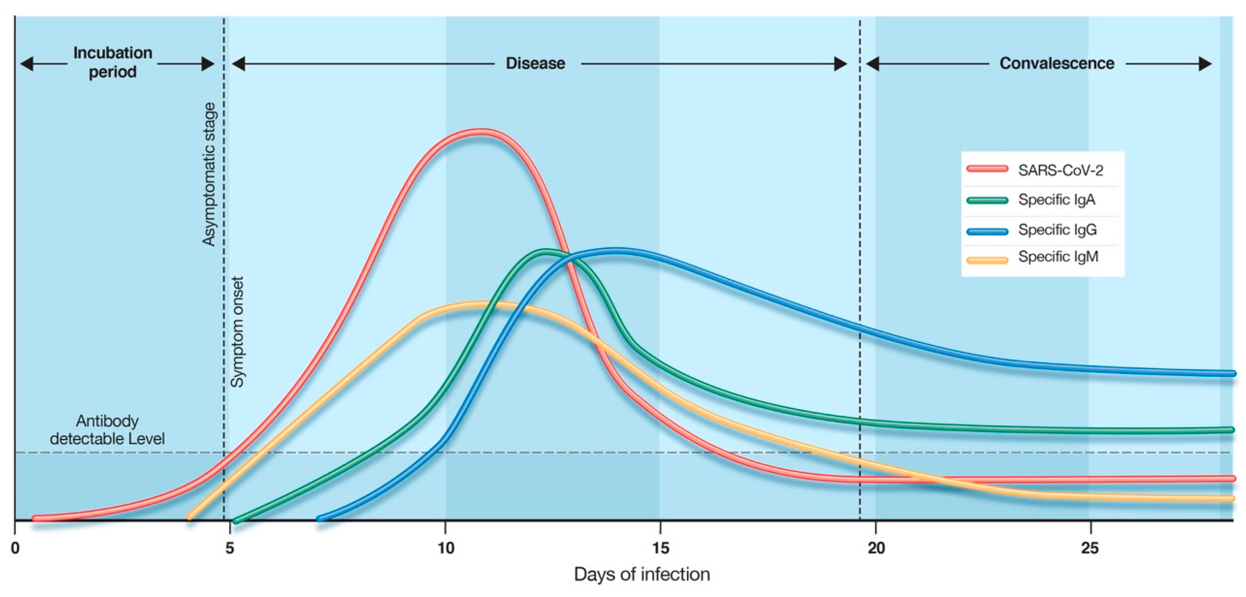
Figure 4. Time kinetics of antibody response in coronavirus disease 2019 (COVID-19). The illustration demonstrates the relative levels of host immunoglobulins (IgM, IgG, IgA) and SARS-CoV-2 viral load at different stages of COVID-19. Antibody-specific seroconversion occurs when the antibody reaches a detectable level in blood. Disclaimer: This graphic is for illustrative purposes only and does not represent actual levels of each antibody.

Slide 22
The kinetics of antibody response
Longevity of antibodies, the ability of antibodies to protect from repeat infection, the protective titer of neutralizing antibody, and the correlation of binding antibody titers to neutralization ability are yet to be determined.
Hence, pending additional data, the presence of antibodies cannot be equated with an individual’s immunity from SARS-CoV-2 infection.

Slide 23
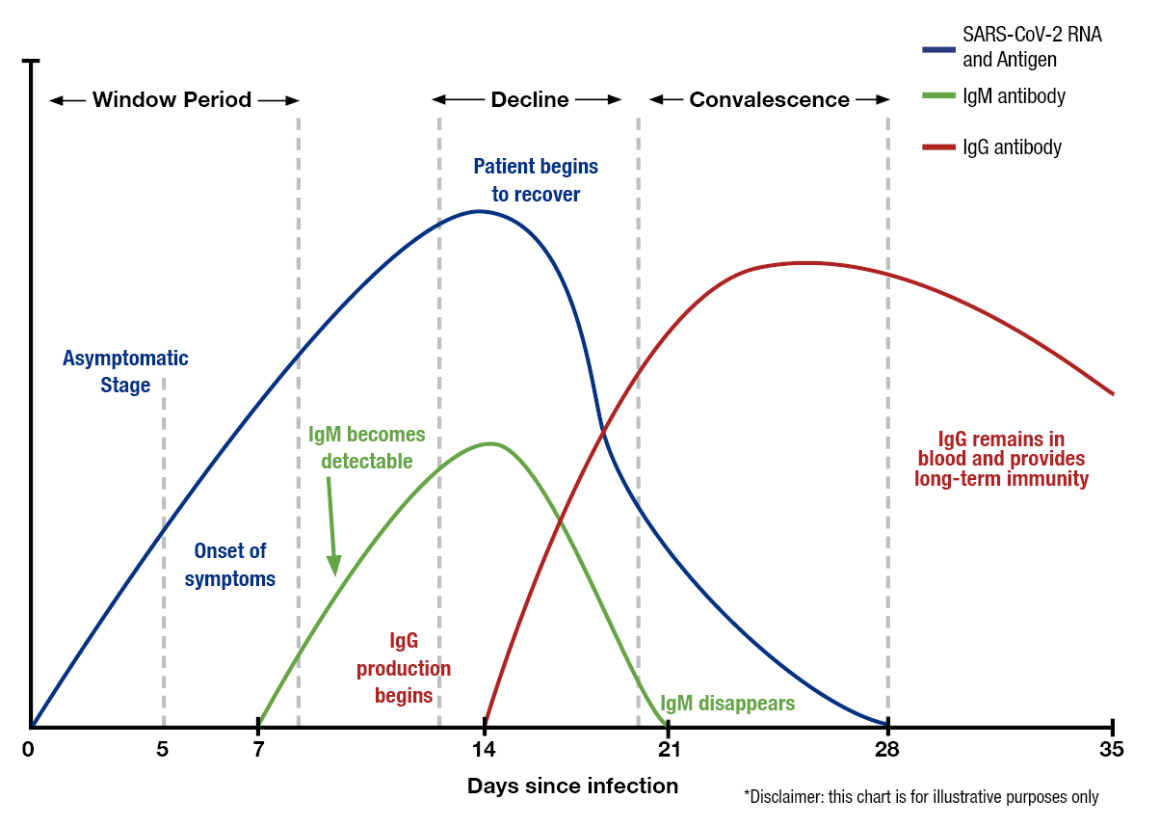
Antibody Kinetics

Slide 24
Neutralizing antibody detection:
Neutralization tests determine the functional ability of antibodies to prevent infection of virus in vitro.
The tests involve incubating serum or plasma with live virus followed by infection and incubation of cells.
Testing will require either BSL-3 or BSL-2 laboratories, depending on what form of the SARS-CoV virus is used.

Slide 25
Two types of neutralization tests are conducted
.
Virus neutralization tests (VNT), such as the plaque-reduction neutralization test (PRNT) and
Microneutralization, use a SARS-CoV-2 virus from a clinical isolate or Recombinant SARS-CoV-2 expressing reporter proteins.
This testing requires BSL-3 laboratories and may take up to 5 days to complete.
Pseudovirus neutralization tests (pVNT) use recombinant pseudoviruses (like vesicular stomatitis virus, VSV) that incorporate the S protein of SARS-CoV-2.
This testing can be performed in BSL-2 laboratories depending on the VSV strain used.

Slide 26
Surrogate virus neutralization tests (sVNT)
The neutralization assay is a lab-based test that uses live virus and cell culture methods to determine if patient antibodies can prevent viral infection in vitro.
This test must be performed in laboratories with designated biosafety certificates to culture SARS-CoV-2-infected cells and has a time-to-result of 3–5 days.

Slide 27
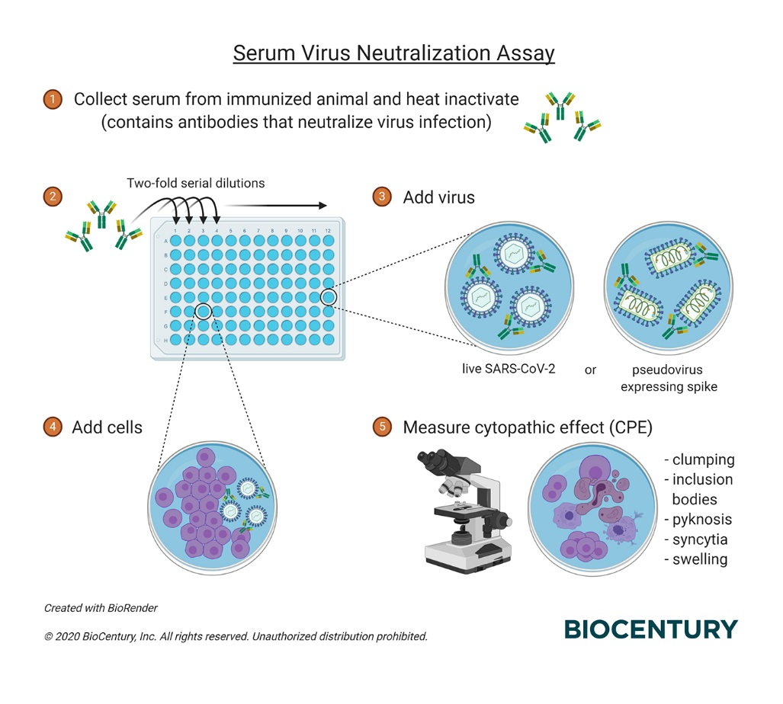

Slide 28
COVID-19 antibody response: pathogenic or protective?
Antibodies against the receptor-binding domain of the spike protein and the nucleocapsid protein have been associated with neutralising activity.
Neutralising antibodies to these domains can be detected approximately 7 days after onset of symptoms and rise steeply over the next 2 weeks.
Several studies showed that patients can remain RNA-positive despite high concentrations of IgM and IgG antibodies against the nucleocapsid protein and the receptor-binding domain of the spike protein.

Slide 29
COVID-19 antibody response: pathogenic or protective?
Whether the presence of neutralising antibodies translates into protective immunity in patients with COVID-19 is unclear.
Some researchers speculate that antibodies can enhance infectivity as higher antibody concentrations have been observed in patients with severe disease than in those with mild disease.
18,25 In one study (n=222), a greater proportion of patients with high IgG concentrations had severe disease than did those with low IgG concentrations (52% vs 32%, p=0·008).
The role of antibody response in the pathogenesis of COVID-19 remains unclear pending further studies

Slide 30
How can countries move forward?
Countries are assessing all available testing options to address their range of needs. In settings where challenges with molecular testing exist or access to laboratories is scarce, rapid serology tests offer a needed additional option.
A rapid serology test with good performance characteristics is extremely important to avoid missing true cases of COVID-19 and imposing unnecessary quarantine for people with false-positive results due to cross-reactivity with seasonal coronaviruses.
Studies have shown more antibody cross-reactivity between the nucleocapsid proteins of SARS-CoV-2 and common coronaviruses than between their spike proteins.

Slide 31
IDEAL testing strategies versus reality
WHO and the Pan American Health Organization have stated that they do not currently recommend the use of immunodiagnostic tests except in research settings, because of scarce information on test performance and appropriate use when immunity to COVID-19 is not well understood.
However, many countries are struggling to scale up testing to implement the key strategies of diagnosing all symptomatic patients and tracing all contacts.
Delays in confirming COVID-19 cases allow continued transmission within communities and can result in failure to contain the pandemic despite other measures such as physical distancing and travel restrictions.

Slide 32
What are low income countries doing?
In Peru, public health facilities for molecular testing are sparse and only 500 beds in intensive care units exist for a population of 32 million.
The Ministry of Health has set up a hotline and website for individuals who have symptoms to be interviewed by a health professional for possible follow-up, prioritizing the visits according to age, risk factors, and severity of symptoms.
A testing team visits the individual at home to do the rapid antibody test.
Individuals who are IgM and IgG positive and have mild symptoms are quarantined, whereas people who need critical care are referred to hospital.
All contacts are also tested with the rapid serology test.
Anyone who tests negative in the antibody test has a swab collected for molecular testing

Slide 33
What are low income countries doing?
May 2, 2020, 355604 people had been triaged in Peru with 42534 testing positive, 26362 of whom were found to be positive by use of a rapid test.
This approach has allowed a large number of symptomatic individuals and contacts to be rapidly tested, relieving the backlog, reducing waiting time for molecular testing, and preventing the health-care system from being overwhelmed

Slide 34
Global partnership for 120 million COVID-19 rapid tests for low- middle-income countries
A full access package includes WHO policy guidance on the use of antigen-based rapid diagnostic tests, manufacturer volume guarantees for low and middle-income countries, catalytic funding to assist governments to deploy the tests and an initial US$50 million procurement fund
Several rapid, point-of-care antigen tests are being assessed by WHO for Emergency Use Listing (EUL)
Agreements between the Bill & Melinda Gates Foundation and test manufacturers
Abbott and SD Biosensor make available innovative tests priced at a maximum of US$5 for low- and middle-income countries (LMICs)
The Global Fund commits an initial US$50 million to enable countries to purchase the new tests, with the first orders expected to be placed this week

Slide 35
Experience in China
Shown that, in symptomatic patients, the use of IgM tests or total antibody tests can increase the sensitivity of COVID-19 case detection.
Further research should explore the performance and utility of rapid antigen-IgM and antigen-IgG combo tests and the timing of testing.
In individuals who test negative for IgG, research should also explore, if resources allow, the value of doing a follow-up antibody test 10–14 days later to document a definitive diagnosis through seroconversion.

Slide 36
Experience from Singapore for antibody testing
Testing all contacts of people with confirmed COVID-19 Studies have shown that a large number of infected individuals could have only mild symptoms or no symptoms at all, but they can still transmit infection, with as much as 44% of infections being transmitted by presymptomatic individuals.
shows that tracking down all contacts of people with confirmed COVID-19, testing them for evidence of infection, regardless of symptoms, and putting those contacts who test positive into isolation is an urgent priority for interrupting the chain of transmission and containing the epidemic.
This approach is particularly important in the early stages when there are only sporadic or clusters of cases, or for countries coming down from the peak to continue to reduce the extent of infection in the community.
Only individuals who test negative should have a throat swab collected for molecular testing, which will reduce the strain on laboratories doing these tests.

Slide 37
Syndromic surveillance, such as surveillance for influenza-like illness or severe acute respiratory infections
Situational analysis and surveillance In countries
where blood or throat swabs are routinely collected
Collected samples can be tested for COVID-19 with molecular, antigen, or serology tests, either alone or in combination.
If any of these samples are positive, it means COVID-19 has been circulating in the community.
Where serial samples are available, it might be possible to date when COVID-19 established itself in a community or country.
.

Slide 38
In general, antibody tests can be used to establish
The true extent of an outbreak
Map its geographical distribution
Identify hotspots and populations that are particularly at risk.
To inform public health measures
Control strategies.
In this case, researchers need to stick to the same serology test and test sentinel populations repeatedly, avoiding the variation in sensitivity between different rapid tests

Slide 39
When is serology testing recommended?
Rapid triage of symptomatic individuals in community settings
Where there is little or no access to molecular testing
Rapid serology tests provide a means to quickly triage suspected cases of COVID-19, provided the test is highly specific for the disease.
A positive result for IgM in symptomatic patients fulfilling COVID-19 case definition is strongly suggestive of SARS-CoV-2 infection.
This approach is probably most effective in individuals 5–10 days after symptom onset

Slide 40
When is serology testing not recommended?
The use of serology tests for population surveys is not recommended in low prevalence settings
Will probably result in more false-positive than true positive results, even if a test with high specificity is used.
For example, if the prevalence of infection is 1% in the general population, a test with 98% specificity will identify two false-positive results for every true positive result.
False sense of security regarding the extent of immunity in the population premature
Easing of public health measures on the basis of misleading disease estimates.

Slide 41
Pitfalls of antibody Tests
Early stage in the disease course, or asymptomatic or pauci symptomatic patients, might have low antibody concentrations that could give false negative results.
Patients’ disease stage and severity are important points to consider, along with the population being tested.
The estimated level of risk can be considered before using a serology test
Because of the changing false positive rate or low positive predictive value across different populations.
Among the groups with the highest risk of the disease are symptomatic patients with clinical presentation of COVID-19, patients with other respiratory symptoms,
Contacts of confirmed cases
Health-care workers in settings with little personal protective equipment.
We suggest countries consider risk levels before using serology tests and creating public health guidance.
Scaling up testing, particularly at the community level, allows for better estimates of risks, which in turn allows more effective public health measures to be put into place than would be otherwise.

Slide 42
Pitfalls of antibody Tests
To date, insufficient evidence exists to recommend the use of serology testing for health-care workers to return to work.
A negative molecular test remains the safest option to establish whether health-care workers can work again safely
Key workers who develop symptoms should be prioritized for molecular testing and receive care if infected.
On recovery, should a serology test be used to decide when they can safely return to work?
This strategy is based on the assumption that antibodies confer protective immunity.

Slide 43
Testing to discharge patients from hospitals
Hospital beds are often in short supply.
The recommended criteria for hospital discharge are two negative molecular tests over several days.
However, molecular testing is often scarce or unavailable.
Can serology tests be used for discharging recovered patients when molecular testing is not available?
As patients can remain positive for viral RNA despite rising concentrations of antibodies against the nucleocapsid protein and receptor-binding domain of the spike protein, which are correlated with neutralising activities,
Antibody tests cannot be used in the place of molecular tests to confirm that the patient is virus-free or at least no longer shedding live virus.

Slide 44
false-positive Ab test
It is important to minimize false-positive test results by choosing an assay with high specificity and by testing populations and individuals with an elevated likelihood of previous exposure to SARS-CoV-2.
Alternatively, an orthogonal testing algorithm (i.e., employing two independent tests in sequence when the first test yields a positive result) can be used when the expected positive predictive value of a single test is low.
However, additional data are needed before modifying public health recommendations based on serologic test results, including decisions on discontinuing physical distancing and using personal protective equipment.

Slide 45
Serologic tests positive points
Important role in understanding the virus’s epidemiology in the general population and identifying groups at higher risk for infection.
Detection tests that can detect acutely infected persons
Individual being tested was previously infected—even if that person never showed symptoms.
Serologic tests detect resolving or past SARS-CoV-2 virus infection indirectly by measuring the person’s humoral immune response to the virus.
Therefore, serologic assays do not typically replace direct detection methods as the primary tool for diagnosing an active SARS-CoV-2 infection,
Have several important applications in monitoring and responding to the COVID-19 pandemic.

Slide 46
Serologic tests positive points
Can help determine the proportion of a population previously infected with SARS-CoV-2
Provide information about populations that may be immune and potentially protected.
Demographic and geographic patterns of serologic test
Which communities may have experienced a higher infection rate and therefore may have a higher proportion of the population with some degree of immunity, at least temporarily.
In some instances, serologic test results may assist with identifying persons potentially infected with SARS-CoV-2 and determining who may qualify to donate blood that can be used to manufacture convalescent plasmaexternal icon as a possible treatment for those who are seriously ill from COVID-19.
In the current pandemic, maximizing specificity and thus positive predictive value in a serologic algorithm is preferred in most instances, since the overall prevalence of antibodies in most populations is likely low.

Slide 47
What should be considered in choosing a Antibody test
► Positive Predictive Value (PPV): Probability that people who test positive are truly positive.
► Negative Predictive Value (NPV): Probability that people who test negative are truly negative.
► Sensitivity: Ability of the test to correctly identify those with the disease (true positive rate).
► Specificity: Ability of the test to correctly identify those without the disease (true negative rate).

Slide 48
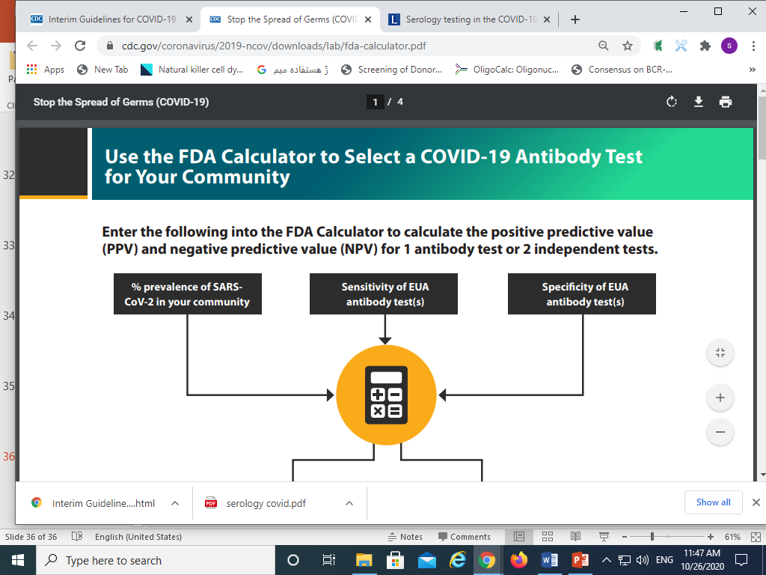

Slide 49
Taking Home Message of Antibody
Some tests may exhibit cross-reactivity with other coronaviruses, such as those that cause the common cold.
This could result in false-positive test results.
Some persons may not develop detectable antibodies after coronavirus infection.
It is possible that antibody levels could wane over time to undetectable levels.
IgM and IgG antibodies may take 1 to 3 weeks to develop after infection.
Thus, serologic test results do not indicate with certainty the presence or absence of current or previous infection with SARS-CoV-2.

Slide 50
Taking Home Message of Antibody
Serologic testing should not be used to determine immune status in individuals until the presence, durability, and duration of immunity are established.
Serologic testing can be offered as a method to support diagnosis of acute COVID-19 illness for persons who present late.*
For persons who present 9–14 days after illness onset, serologic testing can be offered in addition to recommended viral direct detection methods such as polymerase chain reaction or antigen detection tests.
During this time period, the sensitivity of nucleic acid detection is decreasing, and the sensitivity of serologic testing is increasing.
Serologic testing should be offered as a method to help support a diagnosis when patients present with late complications of COVID-19 illness, such as multisystem inflammatory syndrome in children.
Serologic testing by itself should not be used to establish the presence or absence of SARS-CoV-2 infection or reinfection.
Antibodies may not be present among those tested early in illness before antibodies develop or among those who never develop detectable antibodies following infection.
In addition, the presence of antibodies may reflect previous infection and may be unrelated to the current illness.

Slide 51
Recommendations for persons who test positive for anti-SARS-CoV-2 antibodies
Until the durability and duration of immunity are established, it cannot be assumed that individuals who test positive for SARS-CoV-2 antibodies, including total antibody, IgM, IgG, or IgA, are protected from future infection.
Until more information is available about the dynamics of IgA detection in serum, testing for IgA antibodies is not recommended.
Asymptomatic persons who test positive by serologic testing without recent history of a COVID-19 confirmed or compatible illness have a low likelihood of active infection and should follow general recommendations to prevent infection with SARS-CoV-2.
They should continue with normal activities, including work.
Persons who have had a COVID-19 compatible or confirmed illness should follow previous guidance regarding when to resume normal activities, including work, regardless of the presence of antibodies.
There should be no change in clinical practice or use of personal protective equipment (PPE) by health care workers and first responders who test positive for SARS-CoV-2 antibody.

Slide 52
What If you test positive
you may have antibodies from an infection with the virus that causes COVID-19.
However, there is a chance that a positive result means you have antibodies from an infection with a different virus from the same family of viruses (called coronaviruses).
Note: Other coronaviruses cannot produce a positive result on a viral test for SARS-CoV-2.
Having antibodies to the virus that causes COVID-19 may provide protection from getting infected with the virus again.
But even if it does, we do not know how much protection the antibodies may provide or how long this protection may last.
Confirmed and suspected cases of reinfection have been reported, but remain rare.
Talk with your healthcare provider about your test result and the type of test you took to understand what your result means.
Your provider may suggest you take a second type of antibody test to see if the first test was accurate.
You should continue to protect yourself and others since you could get infected with the virus again.
  If you work in a job where you wear personal protective equipment (PPE), continue wearing PPE.
You may test positive for antibodies even if you have never had symptoms of COVID-19.
This can happen if you had an infection without symptoms, which is called an asymptomatic infection.

Slide 53
What If you test negative
You may not have ever had COVID-19.
Talk with your healthcare provider about your test result and the type of test you took to understand what your result means.
You could have a current infection or been recently infected.
  The test may be negative because it typically takes 1–3 weeks after infection for your body to make antibodies.
  It’s possible you could still get sick if you have been exposed to the virus recently.
  This means you could still spread the virus.
  Some people may take even longer to develop antibodies, and some people who are infected may not ever develop antibodies.
If you get symptoms after the antibody test, you might need another test called a viral test​.
Viral tests identify the virus in samples from your respiratory system, such as a swab from the inside of your nose.
Regardless of whether you test positive or negative, the results do not confirm whether you are able to spread the virus that causes COVID-19.
Until we know more, continue to take steps to protect yourself and others.
Learn more about using antibody tests to look for past infection.

Slide 54
Development of Antibodies and Immunity
Nearly all immune-competent individuals will develop an immune response following SARS-CoV-2 infection.
Like infections with other pathogens, SARS-CoV-2 infection elicits development of IgM and IgG antibodies, which are the most useful for assessing antibody response because little is known about IgA response in the blood.
Antibodies in some persons can be detected within the first week of illness onset.
In SARS-CoV-2 infections, IgM and IgG antibodies can arise nearly simultaneously in serum within 2 to 3 weeks after illness onset.
How long IgM and IgG antibodies remain detectable following infection is not known at least 3 month.
It is also important to note that some persons do not develop detectable IgG or IgM antibodies following infection.
Thus, the absence of detectable IgM or IgG antibodies does not necessarily rule out that they could have previously been infected.
In addition, development of neutralizing antibodies can also be assessed.
Neutralizing antibodies inhibit viral replication in vitro, and as with many infectious diseases, their presence correlates with immunity to future infection, at least temporarily.

Slide 55
Recurrence of COVID-19 illness
Recurrence appears to be very uncommon, suggesting that the presence of antibodies could indicate at least short-term immunity to infection with SARS-CoV-2.
Consistent with this observation, experimental primary infection in primates and subsequent development of antibodies resulted in protection from reinfection after the primates were re challenged.
Additionally, antibody development in humans correlates with a marked decrease in viral load in the respiratory tract.
Taken together, these observations suggest that the presence of antibodies may decrease a person’s infectiousness and offer some level of protection from reinfection.
However, it remains uncertain to what degree and for how long individuals with antibodies (neutralizing or total) are protected against reinfection with SARS-CoV-2 or what concentration of antibodies may be needed to provide such protection.

Slide 56
key gaps in our knowledge:
Which serological tests can identify SARS-CoV-2-neutralizing antibodies?
Is there cross-reactivity between neutralizing antibodies and other coronaviruses?
Which SARS-CoV-2 antigens are optimal for the detection of neutralizing antibodies?
What is the correlation between SARS-CoV-2-specific antibodies and protective immunity status?
How long does protective immunity last in recovered patients?
Are individuals susceptible to reinfection with SARS-CoV-2?
Is humoral antibody response the best indicator for protective immunity, or are there other immune-cell-based mechanisms?
In the context of the COVID-19 outbreak and the execution of return-to-work policies, failing to take advantage of available diagnostic tools due to uncertainty can have profound consequences.
Medical professionals frequently rely on imperfect evidence with the possibility of false positives and false negatives.
It is, however, important to clearly understand the limits and potential of serological tests to make informed decisions based on risk and benefit assessment in each specific situation.
In the words of Tedros Adhanom Ghebreyesus, Director-General of the World Health Organization, “Countries cannot fight this pandemic blindfolded.
Countries should know where the cases are.”

Slide 57
Latest Studies
Two studies published Recently demonstrate that COVID-19 immune responses last as long as 8 months, although the authors focus on different reasons
The first study, published in Science Immunology, followed a small cohort of Australians from day 4 to day 242 after infection.
All patients demonstrated the presence of memory B cells—immune cells that "remember" viral proteins and can trigger rapid production of antibodies when re-exposed to the virus—as long as 8 months after initial infection.

Slide 58
Latest Studies
The second study investigated antibody responses in 58 confirmed COVID-19 patients in South Korea 8 months after asymptomatic or mild SARS-CoV-2 infection, finding high rates of serum antibodies.
These results, published in Emerging Infectious Diseases, are contradictory to both the first study's antibody data and previous research that showed antibodies waning after 20 days, but the authors suggest that variations in immunoassay test characteristics and manufacturing may be responsible for the difference.

Slide 59
Latest Studies
Rates differed according to immunoassay methods or manufacturers, thereby explaining differences in rates between the studies For instance
July BMJ study reported chemiluminescent immunoassay tests had 97.8% IgG or IgM sensitivity, whereas enzyme-linked immunosorbent assay tests only had 84.3%.
Virus neutralizing activity—essential for protection from reinfection—was detected in only 53.4% of study participants at 8 months post-infection, considerably lower than the rate of positivity for immunoassays.
"Despite concerns of waning immunity, appropriate immunoassays can detect antibodies against SARS-CoV-2 at 8 months after infection in most asymptomatic or mildly symptomatic persons,"

Slide 60
Conclusions
The events over the past few months have taught us that this pandemic is caused by an extraordinary pathogen that requires extraordinary measures to combat its spread and end the pandemic.
The latest finding that as much as 44% of COVID-19 transmission happens before index cases become symptomatic
Means that a great deal still needs to be learnt about this novel pathogen and its spread through a population.

Slide 61


Slide 62


