Slide 1
بسم ا... الرحمن الرحیم

Slide 2
Dr.Alireza Eshghi
Pediatric pulmonologist
Aliasghar children hospital

Slide 3
LARYNGOTRACHEOBRONCHITIS
(CROUP)

Slide 4
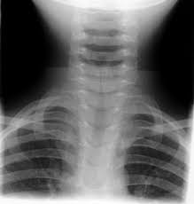
What is your Dx

Slide 5
A 2 y/o boy with URI & stridor

Slide 6
Kind of cough?
Barking cough

Slide 7
In CXR what we see??
STEEPLE SIGN

Slide 8
ETIOLOGY
PARAINFLUENZA VIRUS

Slide 9
SPASMODIC CROUP
AGE: 1-3 Y/O
PSYCOGENIC OR ALLERGIC
NO FEVER
MOSETLY AT NIGHT

Slide 10
Treatment
Dexamethasone
epinephrin

Slide 11
EPINEPHRIN NEBULIZER mod to severe stridor at rest need to intubation respiratory distress hypoxia

