Slide 1
Acute and Chronic Rhinosinusitis in children
Nazanin Farahbakhsh pediatric pulmonologist
Assistant professor at SBMU

Slide 2
ANATOMY
The maxillary sinuses are present at birth and expand rapidly by four years of age
The ethmoid sinuses are present at birth
The sphenoid sinuses, which begin to develop during the first two years of life, are typically pneumatized by five years of age and attain their permanent size by 12
The frontal sinuses develop by age 6-8 Y/O

Slide 3
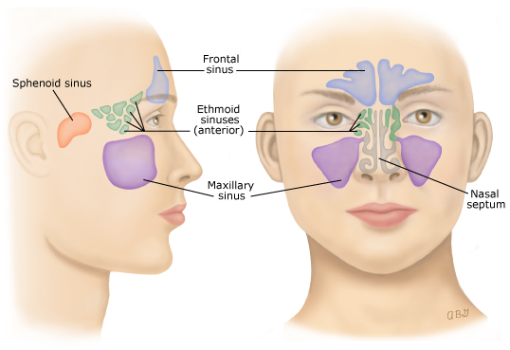

Slide 4
Definition
Sinusitis is inflammation of the mucosal lining of one or more of the paranasal sinuses
Inflammation of the sinuses is common during URTI but usually resolves spontaneously.
ABRS occurs when there is secondary bacterial infection of the sinuses.
Acute – Symptoms completely resolve in <30 days
Chronic sinusitis is defined by episodes of inflammation of the paranasal sinuses that last >90 days, during which patients have persistent symptoms (cough, rhinorrhea, nasal obstruction)

Slide 5
EPIDEMIOLOGY
(ABRS) is a common problem in children
6 to 9% of viral URIs in children
Any age ( peak 4-7 y/o)

Slide 6
PREDISPOSING FACTORS
(URI) is the most important risk factor especially in in children who attend day care
Allergic rhinitis
Anatomic obstruction
Mucosal irritants (dry air, tobacco smoke, chlorinated water)
Sudden changes in atmospheric pressure (descent in an airplane)

Slide 7
CLINICAL FEATURES
The clinical and radiographic manifestations of ABRS in children are similar to those of viral URTI
Cough
Nasal symptoms
Fever
Halitosis
Headache
Facial pain and swelling
Sore throat

Slide 8
Clinical course
Cough, nasal symptoms, and sore throat may occur with both uncomplicated viral URI and ABRS.
The clinical course helps to differentiate ABRS from viral URTI

Slide 9
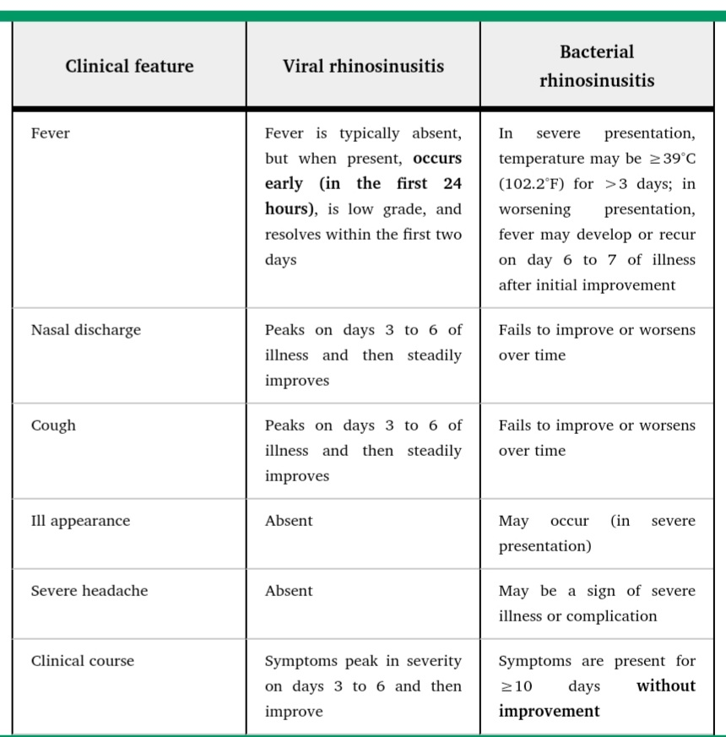

Slide 10
RADIOLOGIC FEATURES
Imaging studies are not usually necessary in the evaluation of children with uncomplicated ABRS
When imaging studies are obtained, abnormal findings should be interpreted in the context of clinical findings
Plain radiographic or computed tomography (CT) findings
Complete opacification
Mucosal thickening of at least 4 mm
Air-fluid level

Slide 11
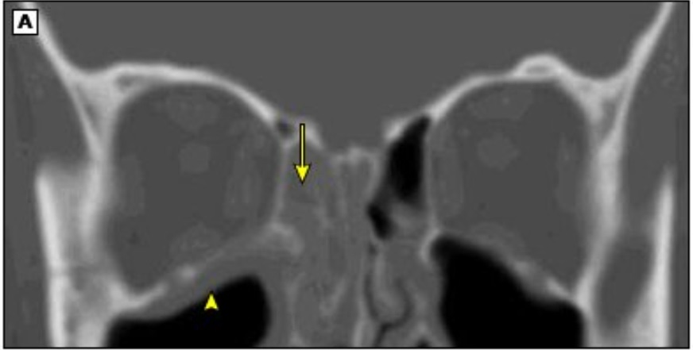
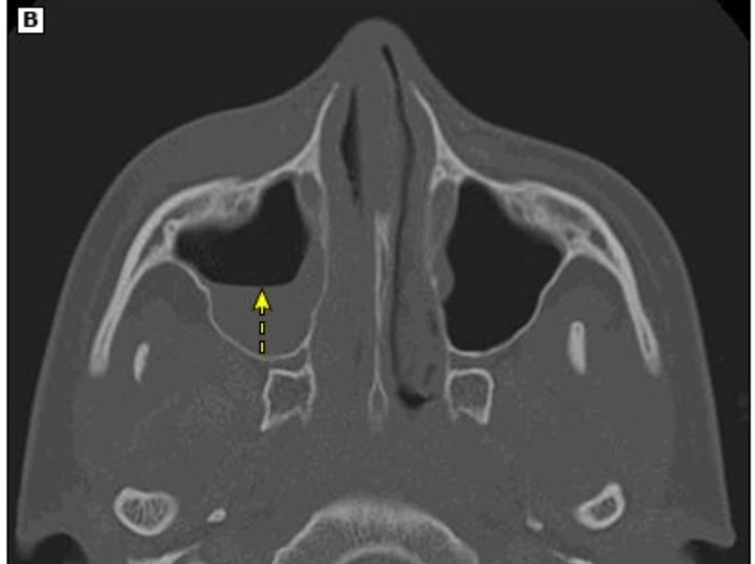

Slide 12
RADIOLOGIC FEATURES
However, abnormal imaging studies cannot distinguish between bacterial, viral, or other causes of sinus inflammation
Normal imaging studies (CT or plain film) of the paranasal sinuses in children with respiratory symptoms excludes rhinosinusitis

Slide 13
DIAGNOSIS
Uncomplicated ABRS
The diagnosis of uncomplicated (ABRS) in children is usually made clinically.
Imaging studies are not recommended for the diagnosis of uncomplicated ABRS .
both of the following criteria be met for diagnosis:
Symptoms and signs compatible with sinus inflammation (daytime cough, nasal symptoms, or both
Clinical course suggestive of bacterial rather than viral infection, including
Symptoms present without improvement for >10 and <30 DAYS OR
Severe symptoms (ill appearance, temperature ≥39°C (102.2°F), and purulent nasal discharge for ≥3 consecutive days), or
Worsening symptoms

Slide 14
DIFFERENTIAL DIAGNOSIS
Other possible diagnoses in children with persistent nasal symptoms and/or cough include:
Structural abnormalities
Pertussis
Allergic rhinitis

Slide 15
MICROBIOLOGY
Haemophilus influenzae (nontypeable)
Streptococcus pneumoniae
Moraxella catarrhalis
Culture of material aspirated from the sinus yielding ≥10 4 colony-forming units/mL of bacteria is the standard for determining the etiology of ABRS.
However, sinus aspiration is an invasive procedure that is not routinely performed in children with uncomplicated ABRS

Slide 16
Risks for antimicrobial resistance
Living in an area with high endemic rates (ie, ≥10 percent) of invasive penicillin nonsusceptible S. pneumoniae
Age < 2 y/o
Daycare attendance
Antibiotic therapy within the past month
Hospitalization within the past five days
Unimmunized or underimmunized with pneumococcal conjugate vaccine

Slide 17
EMPIRIC ANTIBIOTIC THERAPY
When to initiate ?
Immediate treatment may shorten the duration of symptoms, but some children may improve without antibiotics.
Additional factors that are considered in this decision include severity of symptoms, quality of life, past history of ABRS, cost and ease of administration of antibiotics, and concerns about adverse effects of antibiotics or development of complications.

Slide 18
SUGGESTION
Start emperical antibacterial treatment for children with a clinical presentation that is compatible with (ABRS)

Slide 19
Outpatient therapy
amoxicillin-clavulanate is suggested as the first-line agent for the treatment of ABRS
No risk factors for antibiotic resistance
Amoxicillin-clavulanate 45 mg/kg per day
Risk factors for antibiotic resistance
Amoxicillin-clavulanate 90 mg/kg per day

Slide 20
Penicillin allergy
Alternative single-agent regimens, which have a slightly narrower spectrum of activity than amoxicillin-clavulanate, include
a third-generation cephalosporin such as cefpodoxime or cefdinir
Levofloxacin

Slide 21
Vomiting
A single dose of ceftriaxone 50 mg/kg per day ( iv/im)(maximum dose 1 g/day)
Therapy with an oral antibiotic should be initiated 24 hours later, provided the vomiting has resolved

Slide 22
Inpatient therapy
Indications for hospitalization and parenteral antibiotics include
toxic-appearance (eg, lethargic, poorly perfused, cardiorespiratory compromise),
complications or suspected complications
treatment failure with outpatient therapy
Choice of treatment
Ampicillin-sulbactam
Ceftriaxone
Levofloxacin

Slide 23
RESPONSE TO THERAPY
Most patients with acute bacterial rhinosinusitis who are treated with an appropriate antimicrobial agent respond within 48 to 72 hours with improvement of symptoms and general well-being

Slide 24
Treatment failure
causes
Resistant pathogen
Complication
Noninfectious etiology (eg, foreign body, structural abnormality)
Initial presentation of immune deficiency

Slide 25
MANAGEMENT OF TREATMENT FAILURE in out patient
suggest broadening antimicrobial coverage or switching to a different class of antibiotic.
Potential regimens depend on which antibiotic was used initially and might include:
Amoxicillin-clavulanate 90 mg/kg per day
Ceftriaxone 50 mg/kg per day intramuscularly for one to three days, followed by amoxicillin-clavulanate 90 mg/kg per day
Cefpodoxime
Cefdinir
Levofluxin
Imaging and/or sinus aspiration may be indicated to confirm the diagnosis

Slide 26
In hospitalized patients
Contrast-enhanced CT / MRI to exclude orbital and intracranial complications
Quantitative sinus aspirate cultures if they were not obtained at the time of admission
if sinus aspirate cultures are unavailable or contraindicated or or if no pathogens are isolated
addition of vancomycin with or without metronidazole

Slide 27
SYMPTOMATIC TREATMENT
Topical saline
Decongestants and antihistamines(underlying allergic component)
Intranasal corticosteroids(underlying allergic component)

Slide 28
Chronic rhinosinusitis
Chronic Sinusitis: longer than 12 weeks
Some guidelines also requiring :
  Failure to respond to treatment
  One positive imaging study

Slide 29
Chronic Rhinosinusitis in Children
In general :
The main symptoms associated with rhinosinusitis in children are rhinorrhea, nasal obstruction, mouth breathing, hyponasal speech, and snoring
but…

Slide 30
Diagnosing CRS in Children: Special issues
Infants and Pre-school children
Signs/symptoms difficult to evaluate:
    Congestion (very subjective/indirect/parent’s biass)
    Only anterior rhinorrhea is reported
Symptoms impossible to evaluate:
    Posterior discharge
    Sense of smell
    Headache / toothache / facial pain
Symptoms very unspecific :
    Cough, irritability, fever, fatigue/decreased activity, etc.

Slide 31
Diagnosing CRS in Children: Special issues
Infants and Pre-school children
Anterior Rhinoscopy : Limited data
  Anterior third of nasal cavity
  Osteomeatal zone difficult to reach, even w/use of topical decongestant
Nasal Endoscopy: Ideal but impossible to perform without sedation or anesthesia
CT scan: Also requieres sedation or anesthesia
Sedation/anesthesia: increases costs and risks
Increased value of plain X-Rays at this age ??

Slide 32
Clinical presentation of CRS in Children
Diagnosis must be based in a combination of:
  Clinical symptoms and evolution
    Age-group related
    Previous treatments (type and duration)
    Likelihood of allergy involvement: Family history, allergy stigmata, personal history of other allergic diseases (AD or Asthma)
  Clinical Signs
    Anterior rhinoscopy and/or Nasal endoscopy
  Imaging support
    Plain X-Rays
    CT scans
    MRI

Slide 33
Chronic Rhinosinusitis in Children
By definition, needs to be at least 12 weeks old (3 m.o.)
Ethmoid and maxillary sinuses present at birth
Clinical presentation strongly related to the specific pediatric age group:
  Infants: Persistent or recurrent rhinorrhea after an acute febrile URIs ( ± AOM, Rhinopharyngitis, Bronchitis)
  Pre-schoolars: Persistent rhinorrhea and nasal congestion w/adenoid and tonsil hypertrophy, serous OM, allergies and asthma.
  adolescents : Nasal obstruction, headaches, sore throath, hyposmia, irritability, sleep disturbances, etc.

Slide 34
When to suspect CRS in INFANTS
Continuous or intermittent RHINORRHEA
  Anterior, posterior or both
  Usually clear initially (days or weeks)
  Colored (greenish or yellowish) more dense secretions
  It can alternate clear and colored secretions
Nasal CONGESTION
  Mild at the beginning
  Worsening in an intermittent pattern in absence of appropriate treatment
  Not as bad as other age groups
  Objective findings: mouth breathing, snoring

Slide 35
When to suspect CRS in INFANTS
COUGH :
  A prominent feature of sinusitis at this age
  Starts as “Dry” cough usually for several days
  Can continue with “wet” cough all the way
  Intermittent along the day, not very intense
  Can start or worse at night or bedtime
  Usually associated with posterior rhinorrhea
  Also associated with coarse and audible ronchi
  Maybe a better predictor than rhinorrhea about the outcome

Slide 36
When to suspect CRS in INFANTS
FEVER:
  Usually present at the beginning of the clinical picture
  Low or mid grade
  Fades away after few days (with or without treatment)
  Can not be present at all
  Can relapse in the course of the disease (worsening)
  Its absence doesn’t rule out the possibility of chronic infection

Slide 37
When to suspect CRS in INFANTS
Other possible symptoms:
  Irritability
  Bad appetite
  Sleep disturbances:
    Trouble to got sleep
    Restless sleeping
    Nocturnal awakenings
  Halitosis
  Reduced general activity

Slide 38
When to suspect CRS in INFANTS
Physical signs, NASAL :
  Rhinorrhea (anterior)
  Pale and enlarged turbinates
  Mucosal edema
  Hyperemic mucosa
  Middle meatus colored discharge

Slide 39
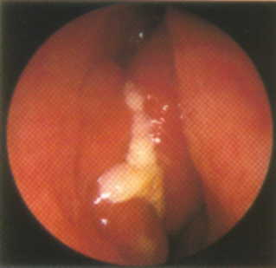
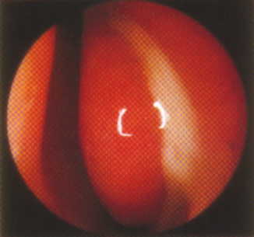
Muco-purulent discharge in the
Sinus Ostium zone
Middle turbinate
Lateral nasal wall
Purulent mucus
Septum

Slide 40
When to suspect CRS in INFANTS
Physical signs, GENERAL :
  Posterior rhinorrhea
  Mouth breathing
  Pallor
  Dark infra-orbital shiners
  Halitosis
  Tympanic opacity, retraction or hyperemia
  Enlarged tonsils
  Granular (cobblestone) adenoid tissue in the pharynx
  “rude” breathing
  Coarse rhonchi on chest examination

Slide 41
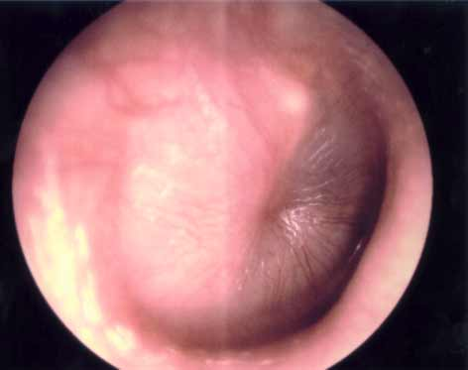
Serous Otitis Media

Slide 42
Plain X-rays vs. CT scan in Sinusitis
The sensitivity of Plain X-Ray compared to CT was:
  77% (30/39)
The specificity of the radiograph to CT was 81% (25/31).
The positive likelihood ratio is 4.05 and
The negative likelihood ratio is 0.28.
Conclusions - The difference between radiographs and CT for diagnosing sinus disease in this population is relatively small but favors CT exam.

Slide 43
Etiology of CRS in Children
Infection:
  Viral/Bacterial ( anaerob/gr neg)
  Biofilms
  Fungal
Allergy
  Allergic Rhinitis: Persistent > Intermittent
Gastroesophageal Reflux
Obstruction /Structural
  Adenoid > Tonsils Hypertrophy
  Septal deviation

Slide 44
Etiology of CRS in Children
Immunodeficiency
  IgA deficiency
  Transient Hipogammaglobulinemia
  IgG sub-class deficiency ( IgG2 + IgG4)
  Selective (polysaccaride) IgG deficiencies
  CVI
Cystic Fibrosis
Ciliary Dyskinesia

Slide 45
Treatment
Antibiotic : staph A. and anaerobes
Topical intra nasal corticosteroid
Nasal irrigation with saline
Surgery( in case of medical treatment failure)
Duration of therapy is up to 3 months, and patient response is unlikely before 2 weeks of use.

Slide 46

Any Questions?

