Slide 1
ACUTE Gasteroenteritis
دکتر سحر همتی متخصص کودکان هیات علمی دانشگاه علوم پزشکی ایران

Slide 2
Diarrhea is the passage of loose or watery stools at least three times in a 24 hour period.
any deviation from the child's usual pattern should raise concern (particularly with ill appearance, the passage of blood or mucus, or dehydration) regardless of the actual number of stools or their water content.
second leading cause of child mortality;
among children younger than 5 years worldwide,
it causes an estimated 1.5 to 2 million deaths annually
duration

Slide 3
ETIOLOGY
infectious gastroenteritis
symptom of a systemic illness
or
an intra-abdominal surgical emergency

Slide 4
Infective + Inflamatory
infective + Non inflammatory
Non infective + inflammatory
Non infective + Non inflammatory

Slide 5
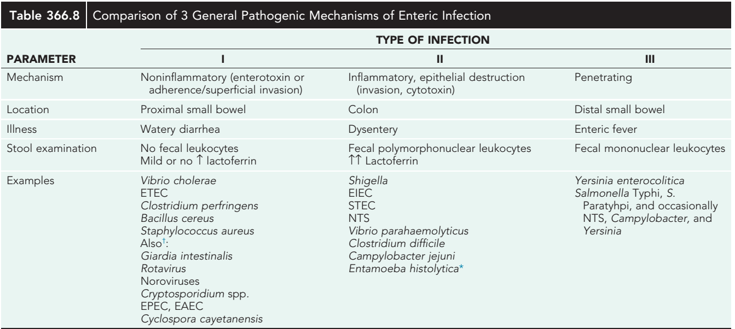

Slide 6
Viral Diarrhea
begin with vomiting
followed by frequent passage of watery nonbloody stools,
associated with fever in about half the cases
The diarrhea lacks fecal leukocytes,
but stools from 20% of cases contain mucus.
Recovery with complete resolution of symptoms generally occurs within 7 days.
disaccharide malabsorption is found in 10–20% of episodes,

Slide 7
Rotavirus
winter months.
moderate to severe disease in infancy but is less severe later in life.
The rotavirus vaccine
Norovirus occurs in people of
all ages,
year round,
the most common cause of outbreaks of acute GE

Slide 8
Other viral causes of acute gastroenteritis include astroviruses, sapovirus, and enteric adenoviruses (serotypes 40 and 41).

Slide 9
Food-borne diarrhea can also result from ingestion of preformed enterotoxins produced by bacteria, such as Staphylococcus aureus and Bacillus cereus,
After a short incubation period, vomiting and cramps are prominent symptoms, and diarrhea may or may not be present.

Slide 10
Bacterial Diarrhea
Fever >40°C,
overt fecal blood,
abdominal pain,
no vomiting before diarrhea onset,
and high stool frequency (>10 per day)

Slide 11
Nontyphoidal Salmonella produces diarrhea by invading the intestinal mucosa.
The organisms are transmitted through contact with infected animals (chickens, iguanas, other reptiles, turtles) or from contaminated food products, such as dairy products, eggs, and poultry.
A large inoculum of organisms is required for disease because Salmonella is killed by gastric acidity.
The incubation period for gastroenteritis ranges from 6 to 72 hours but is usually less than 24 hours.

Slide 12
Shigella dysenteriae
The incubation period is 1-7 days.
Infection is spread by person-to-person contact or by the ingestion of contaminated food with 10-100 organisms.
The colon is selectively affected.
High fever and febrile seizures may occur in addition to diarrhea.

Slide 13
enterotoxigenic (ETEC),
enterohemorrhagic(EHEC) or Shiga toxin–producing (STEC),
enteroinvasive (EIEC),
Enteropathogenic (EPEC),
or enteroaggregative (EAEC).
ETEC : heat-labile (choleralike) enterotoxin, heat-stable enterotoxin , or both.
ETEC is a frequent cause of traveler's diarrhea .

Slide 14
EHEC or STEC, especially the E. coli O157:H7 strain:
hemorrhagic colitis and most cases of diarrhea associated HUS
STEC is associated with contaminated food, including unpasteurized fruit juices and especially undercooked beef, and can present with nonbloody diarrhea that then becomes bloody.
Often no fever

Slide 15
EIEC invades the colonic mucosa, producing widespread mucosal damage with acute inflammation similar to Shigella.
EIEC diarrhea is usually watery and is often associated with fever.
EPEC causes mild watery diarrhea but can cause severe dehydration in young children in resource-poor countries in sporadic or epidemic patterns.

Slide 16
Campylobacter jejuni is spread by person-to-person contact and by contaminated water and food, especially poultry, raw milk, and cheese.
The organism invades the mucosa of the jejunum, ileum, and colon.
GBS

Slide 17
Yersinia enterocolitica:
is transmitted by pets and contaminated food, especially chitterlings.
Infants and young children characteristically have a diarrheal disease,
whereas older children usually have acute lesions of the terminal ileum or acute mesenteric lymphadenitis mimicking appendicitis or Crohn disease.
Post-infectious arthritis, rash, and spondylopathy may develop.

Slide 18
Clostridium dificile causes diarrhea and/or colitis
is usually associated with prior antibiotic exposure.
The organism produces spores that spread from person to person and also as fomites on surfaces.
Infection is generally hospital-acquired,
Diagnosis is made by detection of toxin in the stool.
Infants <12 months of age should not be tested for C. dificile as they are frequently asymptomatically colonized

Slide 19
Amebiasis occurs in warmer climates,
E. histolytica infects the colon;
amebae may pass through the bowel wall and invade the liver, lung, and brain.
Diarrhea is of acute onset,
is bloody,
and contains leukocytes.

Slide 20
G. lamblia is transmitted through ingestion of cysts
The organism adheres to the microvilli of the duodenal and jejunal epithelium.
Insidious onset of progressive anorexia, nausea, gaseousness, abdominal distention, watery diarrhea, secondary lactose intolerance, and weight loss is characteristic of giardiasis.
Cryptosporidium causes mild, watery diarrhea in immunocompetent persons that resolves without treatment.
It produces severe, prolonged diarrhea in persons with acquired immunodeficiency syndrome

Slide 21
Associated conditions
influenza
Measles
HIV
Malaria
covid
Systemic infections :
Serious bacterial infections :
Surgical emergencies :
pneumonia
urinary tract infection meningitis
Sepsis
TSS
AOM
intussusception
appendicitis

Slide 22
Antibiotic-associated diarrhea (AAD)
Functional diarrhea
Congenital diarrhea
Lactase deficiency
Intoxication
Heavy metal
Laxative-induced diarrhea
Other : specially cause chronic diarrhea

Slide 23
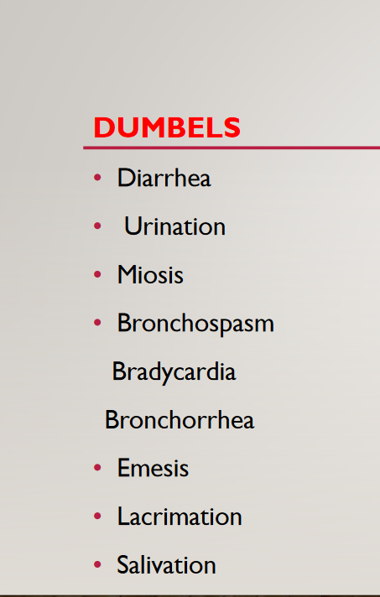

Slide 24
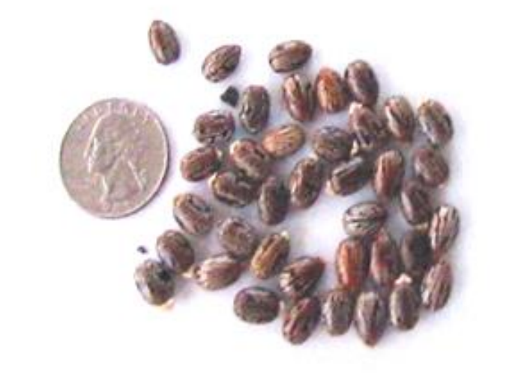

Slide 25
Dx
Electrolyte measurements
Renal function test
CBC – PBS
Blood culture : fever and/or blood in the stool
who are younger than 3 mo,
immunocompromised,
hemolytic anemia
Other risk factors

Slide 27
WBC >5
STEC and E. histolytica usually have negative tests
Stool cultures : clinical features predictive of bacterial moderate or severe disease
immunocompromised outbreaks with suspected hemolytic-uremic syndrome,

