Slide 1
Gastrointestinal Bleeding

Slide 2
Hojat Vahedi, MD
Associate professor of Emergency Medicine
TUMS, Shariati hospital

Slide 3
Acute gastrointestinal (GI) bleeding is a potentially life-threatening condition that requires prompt recognition and treatment.
Upper GI bleeding (UGIB) usually presents as:
hematemesis (blood or coffee-ground emesis)
melena (black, tarry stool).
Lower GI bleeding (LGIB) most frequently presents as:
hematochezia (frank blood per rectum)
red or maroon-colored stool

Slide 4
The goals for evaluation and management
to stabilize the patient
confirm that the gut is the origin of the bleeding
determine the likely site and nature of the bleeding
Provide appropriate therapy.

Slide 5
Inpatient mortality from UGIB and LGIB is estimated to be 10% and 4%

Slide 6
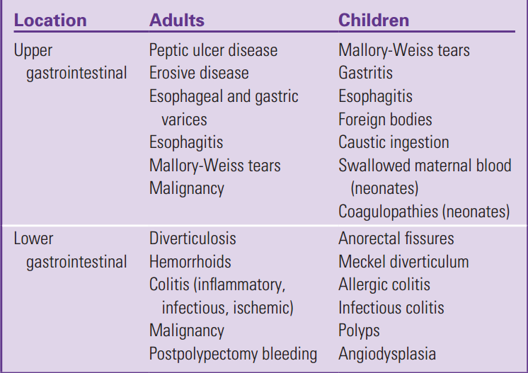
Common Causes of Gastrointestinal Bleeding in Adults and Children

Slide 7
Differential Diagnosis
Patients presenting with an apparent GI bleed should be evaluated for non-GI sources.
Epistaxis can mimic or cause hematemesis
vaginal bleeding can be mistaken for hematochezia.
Some foods (e.g., beets) and medications (e.g., cefdinir) can discolor stools to appear red and bismuth (e.g., in Pepto-Bismol), or iron use can turn the stool black.

Slide 8
Symptoms
UGIB usually presents as hematemesis (either bright red blood or coﬀee-ground emesis) or melena
LGIB generally presents with hematochezia but can present with melena if the origin is proximal in the small bowel
The character of stools is not entirely specifc to the location of the hemorrhage.
small bowel or colonic bleeding with slow transit times can present with melena.
Hematochezia is not limited to LGIB. It can be seen with a brisk UGIB, and upper GI origin should be considered in a hemodynamically unstable patient with hematochezia.

Slide 9
Indicators of shock are more reliable as a gauge of bleeding severity than is the color of the emesis

Slide 10
Epigastric pain may indicate PUD.
Hematemesis that occurs afer vomiting or retching is seen with esophageal tears.
Unexplained weight loss is suggestive of malignancy.
Constipation or painful bowel movements may precede bleeding from hemorrhoids or an anal fssure, respectively.

Slide 11
Symptoms indicative of cerebral hypoperfusion, such as lightheadedness, are predictive of more severe hemorrhage
Susceptible patients with signifcant blood loss may develop acute coronary syndrome (ACS)
Patients with signifcant blood loss should be queried for a history of coronary disease, but typical symptoms of ACS, such as chest pain or shortness of breath, may not be present in UGIB patients

Slide 12
Signs
Patients with acute GI bleeding should be assessed for signs of shock, which increases risk for death.
Tachycardia and hypotension are predictive of a severe bleed.
A shock index (heart rate divided by systolic blood pressure) can be used to guide resuscitation

Slide 13
On physical examination, patients with PUD or severe gastritis may have tenderness in the lef upper quadrant.
The presence of ascites may indicate portal hypertension, increasing the likelihood of esophageal varices. In such cases, rectal examination may identify varices or dense collateral veins around the anus and rectum.

Slide 14
Diﬀuse abdominal tenderness may indicate GI perforation or bowel ischemia.
A digital rectal exam can help in elucidating the type or severity of bleeding
Hemorrhoids or anal fssures may be apparent on rectal exam.

Slide 15
Laboratory Testing
focused on risk stratification
Patients with hemodynamic instability require rapid resuscitation before laboratory results become available.
An initial lactate level greater than 2.5 mmol/L is associated with the development of inhospital hypotension and increased 30-day mortality.
An initial international normalized ratio (INR) greater than 1.5 or a hemoglobin less than 10 g/dL is predictive of increased inpatient mortality and the need for intensive care unit (ICU) admission.

Slide 16
Isolated azotemia is ofen seen in patients with UGIB
A blood urea nitrogen to creatinine (BUN:Cr) ratio higher than 35 is 90% specifc in identifying UGIB.
BUN:Cr ratio is poorly sensitive and not useful in excluding an UGIB.
Blood is typed and screened for stable patients and crossmatched for unstable patients.
Use uncrossmatched blood product transfusion for patients with ongoing brisk hemorrhage requiring rapid resuscitation

Slide 17
Electrocardiogram
screening electrocardiogram (ECG):
patients older than the age of 35 years
those with cardiac risk factors.
A history of diabetes, tobacco use, liver cirrhosis, anemia (hemoglobin <9 g/dL), or prior episodes of ACS are risk factors

Slide 18
Nasogastric Aspirate Testing
We do not recommend the routine placement of a nasogastric tube (NGT)
The procedure is both uncomfortable and potentially time-consuming
NGT lavage performed before endoscopy should be left to the endoscopist and performed as part of that procedure.

Slide 19
Imaging
Bedside ultrasound can confrm the presence of ascites, increasing the likelihood that esophageal varices are the cause of UGIB.
The American College of Radiology (ACR) Appropriateness Criteria state that endoscopy is preferred before radiologic imaging for patients with signifcant UGIB

Slide 20
The ACR recommends angiography as an appropriate alternative in unstable patients with suspected LGIB, because this modality can potentially be used to both localize and embolize bleeding sources.

Slide 21
CTA is capable of detecting bleeding as slow as 0.3 mL/min.
It is useful if endoscopic localization of the hemorrhage is not possible or unsuccessful. CTA should be considered, in consultation with gastroenterology, for stable patients with LGIB to assist in identifying the hemorrhage location

Slide 22
CTA is not optimal in hemodynamically unstable patients with suspected LGIB, because it may delay management.
Immediate conventional angiography (with potential embolization) is the preferable strategy for these patients.

Slide 23
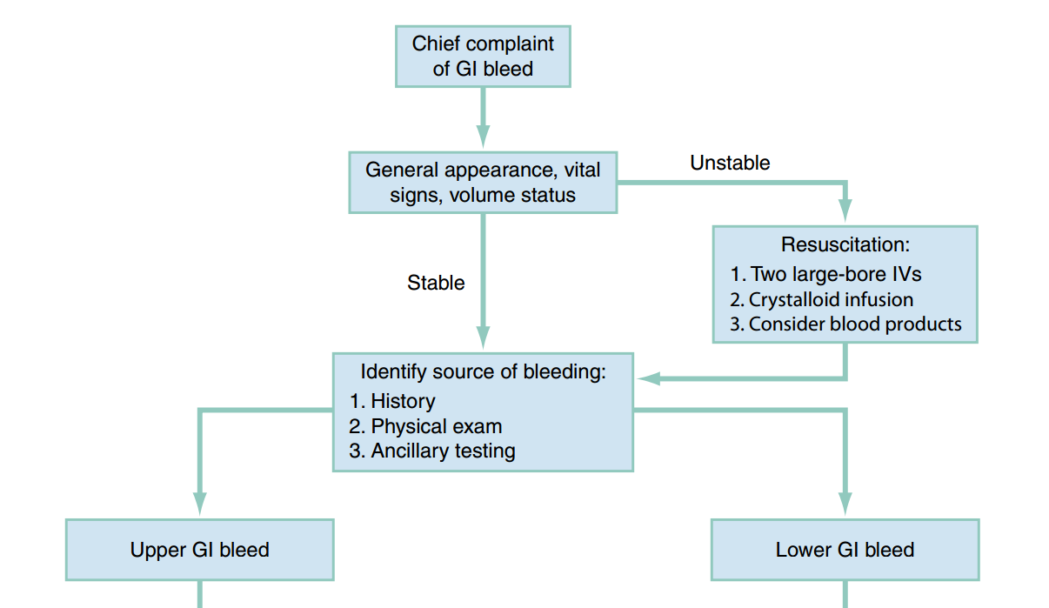

Slide 24
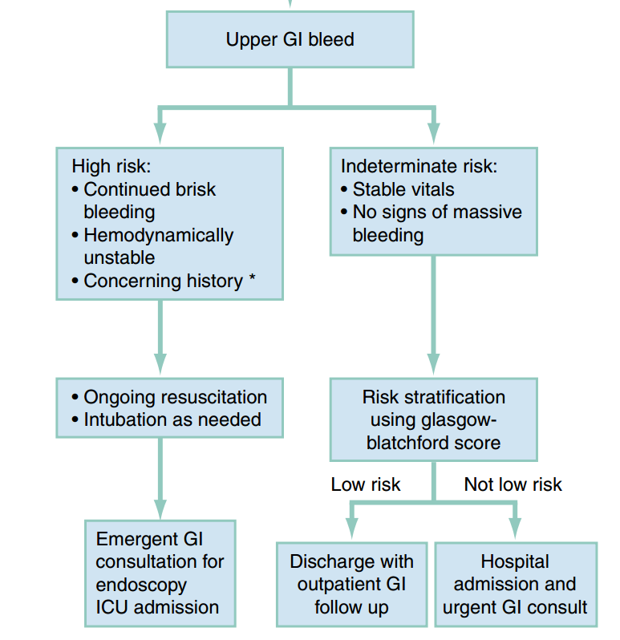
Concerning history includes:
• Estimated blood loss >500 mL as suggested by symptoms of hypovolemia: dizziness, lightheadedness, syncope, confusion, and weakness
• History of previous abdominal vascular surgeries
• Use of anti-coagulants
• Initial lactate >4
• Hemoglobin <10 or decrease >1 from baseline

Slide 25
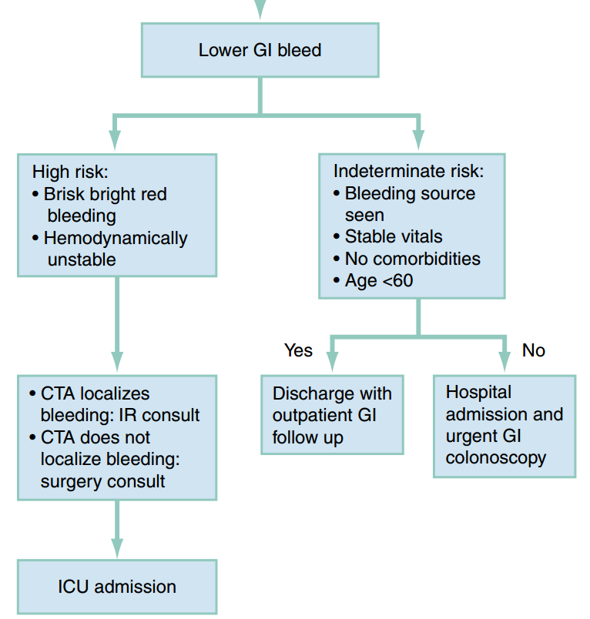

Slide 26
MANAGEMENT
prompt resuscitation
consideration of blood or platelet transfusion
pharmacologic therapy
early consultation with gastroenterology, interventional radiology, or surgery
For patients with massive UGIB, early attention to airway protection and intubation

Slide 27
Resuscitation
All patients who present with an acute GI bleed have a minimum of two large bore IV catheters placed.
Patients with signs of impending hemodynamic compromise (tachycardia, hypotension, diminished mental status) should have crystalloid ﬂuids rapidly infused, with a goal of delivering 2 L over the frst 30 minutes.
patients with a massive bleed (active hematemesis or hematochezia with a shock index >0.9) should receive an immediate transfusion of PRBCs

Slide 28
Patients with massive UGIB with uncontrollable hematemesis, respiratory distress, or severe shock limiting their ability to protect the airway or cooperate with treatment should be intubated early in their resuscitative course, unless they respond rapidly to treatment

Slide 29
Blood Product Transfusion
stable patients with an UGIB without known coronary artery disease (CAD) should receive transfusion of red blood cells to restore their hemoglobin to at least 8 g/dL
A higher hemoglobin target is appropriate for patients with known CAD who are at increased risk of adverse outcomes from anemia.
transfusion to a minimum hemoglobin greater than 9 g/dL for patients with known or symptomatic CAD or to the level necessary to resolve cardiac ischemia

Slide 30
For patients with suspected portal hypertension overtransfusion may worsen portal hypertension and increase bleeding

Slide 31
Maintaining a platelet count of greater than 50,000 platelets/μL.
Empiric platelet transfusion for patients on antiplatelet medications who are not thrombocytopenic is unlikely to be of benefit and therefore not recommended.

Slide 32
In patients requiring massive transfusion (more than 4 units of PRBCs), we recommend a balanced transfusion approach of 1:1:1 PRBC:platelets:FFP
The administration of FFP and PCC may increase the rate of thrombotic events, so their routine use in patients with liver failure and acute GI bleeding is not recommended unless receiving massive transfusion.

Slide 33
known benefits of early endoscopy for acute UGIB, endoscopy should generally not be postponed while awaiting correction of coagulopathy

Slide 34
INR, PT, and PTT have less of a role in the management of GI bleeding in patients on direct oral anticoagulants such as dabigatran or factor Xa inhibitors (apixaban, rivaroxaban, edoxaban).
Reversal agents may be used in unstable patients.
Idarucizumab can be utilized to reverse dabigatran.
PCC or coagulation factor Xa [recombinant], inactivated-zhzo may be used to reverse factor Xa inhibitors

Slide 35
Pharmacologic Therapy
treatment with a high-dose, continuous PPI infusion has been shown to decrease rebleeding, surgery, and mortality in patients with bleeding ulcers
a single dose of IV omeprazole 80 mg as a cost-eﬀective and less time-consuming treatment option.
This is followed by subsequent doses of 40 mg every 12 hours

Slide 36
Splanchnic vasoconstrictors such as somatostatin and octreotide reduce portal hypertension and decrease risks of bleeding and transfusion requirements in patients with variceal bleeding.
octreotide 50 μg IV bolus (or an equivalent agent), followed by 50 μg/h continuous infusion for patients with acute UGIB and known liver disease, variceal bleeding, alcoholism, or abnormal liver function tests
There is no rationale for the routine administration of these agents in patients with presumed nonvariceal bleeding.

Slide 37
Prokinetic agents such as erythromycin administered prior to endoscopy improve visualization, limit the need for repeat esophagogastroduodenoscopy (EGD), decrease blood transfusion requirements, and decrease hospital length of stay for patients with severe or active UGIB.
For patients going directly for EGD from the ED, a single dose of erythromycin 250 mg IV should be administered 30 to 120 minutes prior to EGD.

Slide 38
Tranexamic acid is an antifbrinolytic agent that improves outcomes in the settings of postpartum hemorrhage and trauma.
Tere are currently insufcient clinical data to recommend the use of tranexamic acid in patients with GI bleeding

Slide 39
For the specific subset of patients with UGIB and known or suspected cirrhosis, antibiotic prophylaxis is recommended.
Antibiotics reduce the rate of bacterial infection and mortality.
Fluoroquinolones (e.g., ciproﬂoxacin 400 mg IV) or a third-generation cephalosporin (e.g., cefriaxone 1 to 2 g IV) are appropriate prophylactic antibiotics

Slide 40
Balloon Tamponade
For rapidly exsanguinating patients with a presumed variceal bleed, the placement of a balloon tamponade device is indicated when endoscopy is not promptly available.
Commercially available devices include the Sengstaken-Blakemore tube and the Minnesota tube.
significant complications
only as a temporizing measure for patients with ongoing, life-threatening bleeding.

Slide 41
Definitive Treatment
Early consultation.
For patients with a brisk LGIB, emergent consultation with an interventional radiologist for possible selective embolization. also simultaneous consultation with surgery.
If a source of bleeding is not readily identifed with CTA, unstable patients with brisk LGIB may require urgent surgical intervention

Slide 42
QUESTION???

Slide 43
THANK YOU
FOR
YOUR ATTENTION

