Slide 1
بنام خدا

Slide 2
Treatment and Complications
دکتر مطهره آقاجانی دلاور
متخصص کودکان
هیات علمی دانشگاه علوم پزشکی ایران

Slide 3
TABLE OF CONTENTS
01
05
02
03
04
Hydration
Antibiotic Therapy
06
Enteral Feeding
Prevention
07
Zinc
Chronic diarrhea
08
Additional Therapies
Complications

Slide 4
Hydration
More susceptible than adults to dehydration
Dehydration must be evaluated rapidly
correct in 4-6 hr
ORT or IV??
ORS
emesis

Slide 5
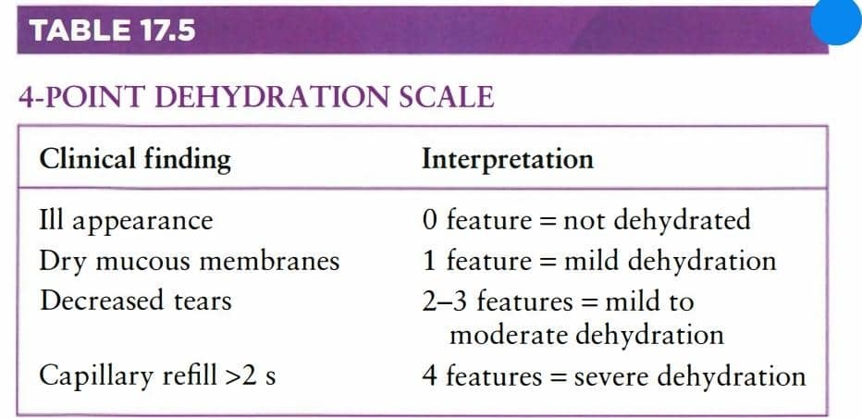
Dehydration

Slide 6
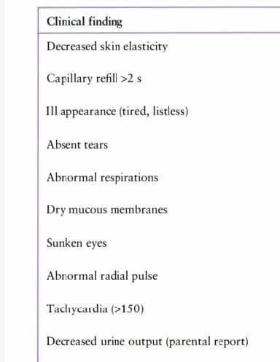
Dehydration

Slide 7
Dehydration
mild
moderate
severe

Slide 8
Rehydration Therapy
mild
moderate
1cc/kg Q5min over 4 h
2cc/kg Q5min over 4 h

Slide 9
Rehydration Therapy
severe
shock
20 cc/kg over 20 min x 3

Slide 10
types of fluid
Ongoing loss
deficit
maintenance

Slide 11
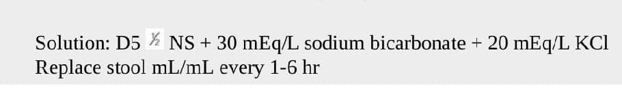

Ongoing loss
6 h

Slide 12
Diet Selection
Zinc
Additional Therapies
ا

Slide 13
Antibiotic Therapy
Shigella
• Ciprofloxacin
• Ceftriaxone
• Azithromycin
• Cefixime
• Trimethoprim-sulfamethoxazole
ETEC
• Azithromycin
• Ciprofloxacin
STEC
Avoid antimicrobials and anti-motility drugs

Slide 14
Antibiotic Therapy
Salmonella ,
non-typhoidal
treatment of Shigella
Yersinia spp.
•cephalosporins.
•doxycycline
• Aminoglycoside
• TMP-SMX
• fluoroquinolone.
Campylobacter
• Erythromycin
• Azithromycin
•Fluoroquinolone

Slide 15
Clostridium
Difficile
• Metronidazole
• Vancomycin
Entamoeba
Histolytica
• Metronidazole
• Tinidazole
• Paromomycin
• Iodoquinol
Giardia
Intestinalis
• Tinidazole
• Metronidazole

Slide 16
Cryptosporidium
• Nitazoxanide
• paromomycin
+azithromycin
Cyclospora
• TMP and SMX
Blastocystis
Hominis
• Metronidazole

Slide 17
Prevention
Breastfeeding
Vitamin A
Rotavirus
Immunization

Slide 18

Chronic diarrhea
replacement of fluid and electrolyte
Nutritional rehabilitation
Zinc
Micronutrient and vitamin
lactose-free diet
Functional diarrhea 4F
parenteral nutrition

Slide 19
Complications
Intussusception
Hemolytic uremic syndrome (HUS)
Shock

Slide 20
سپاس
تشکر و سپاس فراوان از شما که وقت گذاشتید
سپاس و قدردانی ازهمکاران حمایتگرم در اورژانس بیمارستان علی اصغر
تشکر و قدردانی ویژه ازدوستان نظام پزشکی شهریار در جهت هماهنگی این وبینار

