Slide 1

Prevalence, Incidence & Mortality of HCV

Slide 2
1
Prevalence, Size Estimation

Slide 3
Size Estimation
(Adult Population)
Using Prevalence
Meta-Analysis Studies
Using Statistical Modeling
Compartmental Model (SIR)
Polaris Observatory

Slide 4
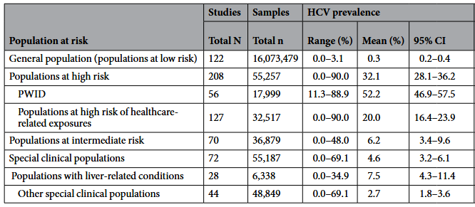
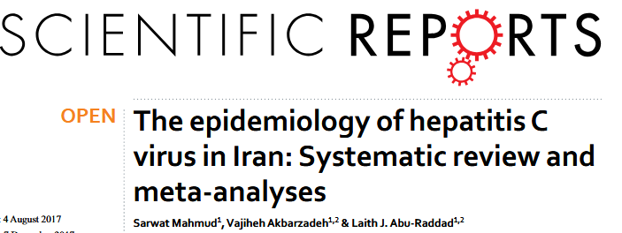
Prevalence in General Population
The epidemiology of hepatitis C virus in Iran: Systematic review and meta-analyses (Search=June 2016).
General populations (that is populations at low risk): these consisted of blood donors, pregnant women, children, healthy adults, and army recruits, among other general population groups.

Slide 5
Size Estimation using Prevalence
Prevalence of 0.3% (Seroprevalence) in 2016
Population based on Iran Statistics Center (Adult Population= 60,000,000) = 180,000 individuals
Size Estimation using Updated Prevalence
Prevalence of 0.2% (Seroprevalence) (Polaris Observatory)
Population based on Iran Statistics Center (60,000,000) = 120,000 individuals
Prevalence of 0.15% (Viremic prevalence, Spontaneous clearance rate=0.25)
Population based on Iran Statistics Center (60,000,000) = 90,000 individuals

Slide 6
Compartmental Models (SIR), Model Parameters
Parameter | Definition | Value & Source
γ (gamma) | Spontaneous clearance rate | 0.25 – Hajarizadeh et al., 2013
α (alpha) | Treatment success rate (SVR) | 0.95 – WHO, 2022
μ (mu) | Mortality rate from chronic HCV | 0.01 – WHO estimate
β (beta) | Force of infection | ~11/100,000/year
τ (tau) | Annual treatment rate for chronic | 0.1 – Tehran Times, 2023
ψ (psi) | Exit rate from acute phase | 2.0 – 6-month duration
σ (sigma) | Loss of immunity rate | Very low – assumed ~0
S (0) | Initial susceptible population | ~65 million – Iran stats
PWID Prevalence | HCV in injecting drug users | 52.2% – Mahmud et al., 2018

Slide 7
Compartmental Models (SIR), Output
The current burden of active HCV infection is estimated at ~0.18% of the population, corresponding to 120,000 individuals (adult) nationwide.

Slide 8
Size Estimation
(PWID)
Using Prevalence
Meta-Analysis Studies

Slide 9
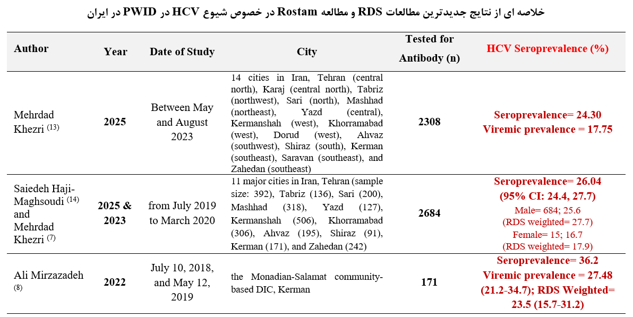
PWID

Slide 10
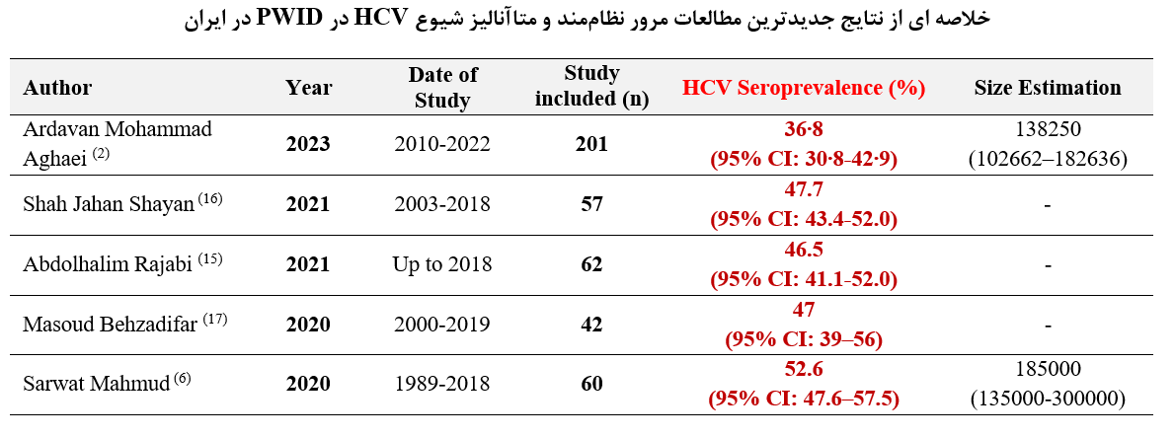
PWID

Slide 11
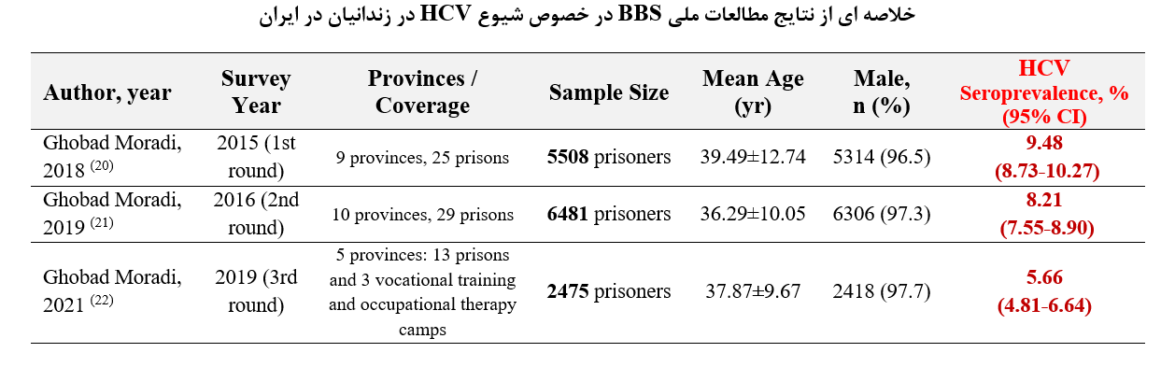
Prisoners

Slide 12
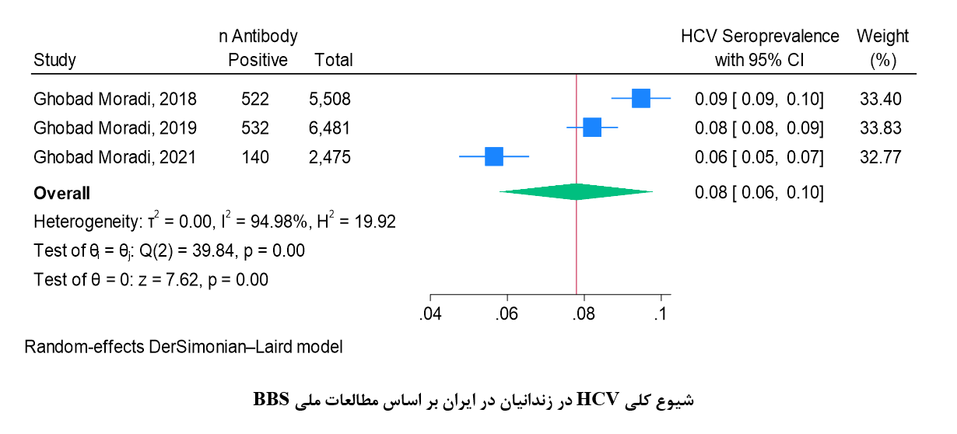
Prisoners
Pooled Seroprevalence= 8.7% (95% CI: 8.5-8.9)

Slide 13
2
Incidence

Slide 14
Future Plans
Incidence Rate
(Adult Population)
Updated Original Researches
By Year of study
(2020-2025)
Simple Formula for Incidence
Back-Calculation
Incidence = Prevalence / [Duration × (1 − Prevalence)]
1) Age-specific Seroprevalence (Prevalence)
2) Treatment Data (Cure)
3) Mortality Data
4) Epidemiology Context → Size of key population (PWID, Prisoners , …)
Dynamic Compartmental Models (e.g. SIR)
Susceptible, Infected-Acute, Infected-Chronic, Treated, Recovered
Force-of-Infection (FoI)
Modeling from Prevalence data

Slide 15
Future Plans
Incidence
(PWID)
Updated Studies
By Year of study
(2020-2025)
Using Statistical Modeling
Different Models with Different Scenarios
Conduct Research Project
RDS Study
Time-Location Study

Slide 16
3
Mortality Rate

Slide 17
Future Plans
Mortality Rate
Using National Death Registry
Related to Hepatitis C and B
Using National Cancer Registry
Proportion of Hepatocellular Carcinoma (HCC)-related deaths attributable to hepatitis C and B
Attributable Deaths Formula
Total HCC cases × Attributable fraction to HCV/HBV × (1 − Survival rate)

